Slide 1
Consumer Financial Protection Bureau
Montana Financial Education Coalition| April 3, 2018

Slide 2
Disclaimer
This presentation is being made by a Consumer Financial Protection Bureau representative on behalf of the Bureau. It does not constitute legal interpretation, guidance or advice of the Consumer Financial Protection Bureau. Any opinions or views stated by the presenter are the presenter’s own and may not represent the Bureau’s views.
This document was used in support of a live discussion. As such, it does not necessarily express the entirety of that discussion nor the relative emphasis of topics therein.
2

Slide 3
CFPB representatives
Jenefer Duane
Senior Program Analyst
Office for Older Americans
Tami Sieckman
Outreach Coordinator
Office for Older Americans
3

Slide 4
What we’ll cover
Background on the CFPB – who we are?
Financial education tools and resources
Hearing from consumers
Overview of the Office for Older Americans
4

Slide 5
Background on the CFPB
Who we are

Slide 6
CFPB’s Statutory Objectives - DFA
OBJECTIVES. – The Bureau is authorized to exercise its authorities for the purposes of ensuring that, with respect to consumer financial products and services –
    Consumers are provided with timely and understandable information to make responsible decisions about financial transactions;
    Consumers are protected from unfair, deceptive, or abusive acts and practices and from discrimination;
    Outdated, unnecessary, or unduly burdensome regulations are regularly identified and addressed in order to reduce unwarranted regulatory burdens;
    Federal consumer financial law is enforced consistently, without regard to the status of a person as a depository institution, in order to promote fair competition; and
    Markets for consumer financial products and services operate transparently and efficiently to facilitate access and innovation.
Notes:
DFA – stands for Dodd-Frank Act

Slide 7
CEE: Mission and Vision
MISSION
To regulate the offering and provision of consumer financial products or services under the Federal consumer financial laws and to educate and empower consumers to make better informed financial decisions.
VISION
Free, innovative, competitive, and transparent consumer finance markets where the rights of all parties are protected by the rule of law and where consumers are free to choose the products and services that best fit their individual needs.

Slide 8
CEE: Mission and Approach to Financial Education
CEE creates opportunities for people to enable themselves to make choices about money that better serve their own life goals.
MISSION
APPROACH
CEE accomplishes this mission by developing and maintaining tools, programs, and initiatives that provide information to consumers, help to build skills, and serve individual financial well-being. We help Americans:
1
Connect with information and tools to help understand money management and other money topics
2
Develop overall financial capability skills in financial decision making, to support people as they identify and respond to the opportunities and challenges of their financial lives, build individual wealth, and prepare for ongoing and later life financial security
3
Take steps to prepare the next generation for financial success by developing money management habits and skills for youth

Slide 9

CFPB overview: Organization
Consumer Education and
Engagement
Responsible for developing and implementing initiatives to educate and empower consumers to make better-informed financial decisions
Supervision, Enforcement,
and Fair Lending
Supervises banks, some credit unions, and other financial companies, and enforces Federal consumer financial laws
Research, Markets,
and Regulations
Leads the Bureau’s rulemaking for Federal consumer financial laws, and efforts to articulate an informed perspective about current issues in consumer financial markets and regulations
Legal Division
Responsible for the Bureau’s interpretation of and compliance with applicable laws; advises the Director and the Bureau’s divisions
Ensures that perspectives of consumers, industry, advocacy groups, state and federal officials, and other stakeholders shape our work, and helps keep them informed about CFPB initiatives
External Affairs
Operations
Sustains the CFPB’s operational infrastructure to support the Bureau’s growth and enable its success
Hears directly from consumers about the challenges they face in the marketplace, brings their concerns to the attention of companies, and assists in addressing their complaints.
Consumer Response

Slide 10
Meet Consumer Education & Engagement
Financial Education
Provide targeted educational content
Identify and provide effective financial education practices
Consumer Engagement
Create interactive, informative relationships with consumers
Servicemembers | Older Americans | Students and Young Consumers | Financial Empowerment
Improve financial protection | Protect against financial abuse | Increase awareness of debt in college choice | Empowering economically vulnerable consumers to make informed financial decisions
Monitor complaints | Improve financial literacy | Monitor complaints | 68 million unbanked or underbanked
Coordinate with Department of Defense and military service organizations | Help with planning for life events | Build campus awareness | Work with non-profit, public, and private organizations
Audience: 2.2 million military personnel and 22.6 million veterans | Audience: 50 million aged 62+ | Audience: 22-28 million (age 16-26) | Audience: 33% of Americans earn less than twice the poverty line
10
Notes:
We are encouraging and supporting expanded access to financial education in the classroom, in the workplace, in libraries, in social service agencies, for servicemembers and veterans, for older Americans, for the many underserved consumers, and for all consumers generally.

Slide 11
Financial Education
On-Line Interactive Tools

Slide 12
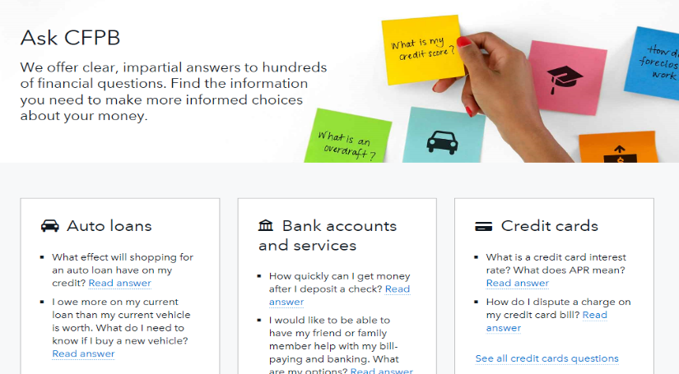
Ask CFPB
consumerfinance.gov/askcfpb
Notes:
This is the most visited consumer tool on cf.gov. Receiving over six million visitors each year.
Launched in March 2012, updated in March 2016 to enhance user experience. Page satisfaction rating jumped to 84% since the update.
Approximately 1,000 questions about money topics and financial products and services, including
Credit cards
Mortgages
Student loans
Bank accounts
Credit reports
Debt collection

Slide 13
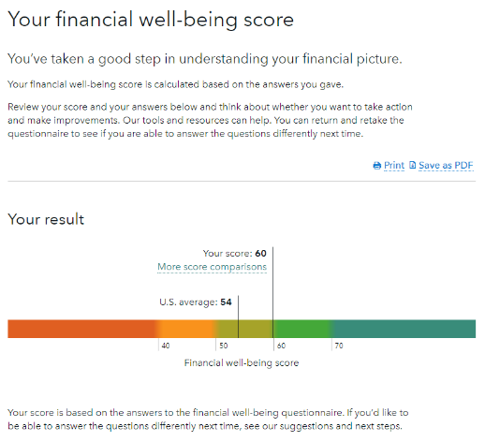
Find out your financial well-being
consumerfinance.gov/consumer-tools/financial-well-being
Ten questions to show consumers their financial well-being score, with tips for improving it
Links to background on financial well-being, what it means, and what affects it
Optimized for mobile use
Privacy is protected; no answers or scores are collected or stored
Shows quick comparisons by
age, household income, and employment status
Notes:
Read off slide

Slide 14
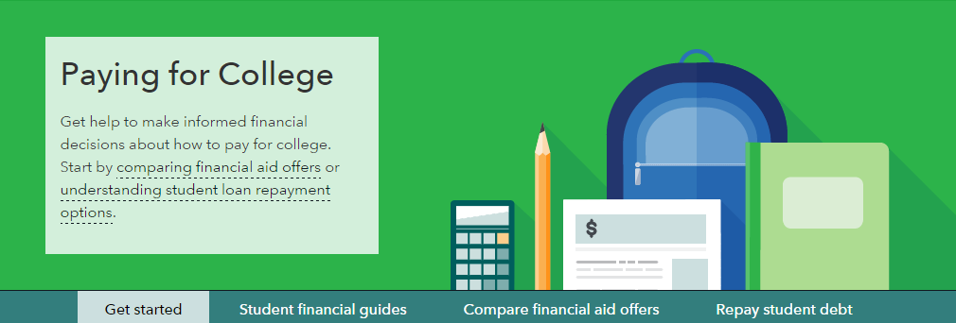
Paying for College
consumerfinance.gov/paying-for-college
Paying for college is a set of online tools targeted to students and families evaluating their options when financing a higher education
Provides information about financing college including:
  Comparing college costs and financial aid offers
  Shopping for a loan
  Options to repay student loan debt
Notes:
Paying for college is a set of online tools targeted to students and families evaluating their options when financing a higher education.
Address the entire lifecycle of financing college – comparing college costs and financial aid offers, to shopping for a loan, through assessing options to repay student loan debt.
The Bureau hosts a number of additional tools and resources that can help students and families navigate banking products, such as checking accounts, on campus.
Originally Launched in 2012. In August 2016, a new component was added to support CFPB’s enforcement action – certain For-profit colleges in settlement with Dept of Justice, State AGs and CFPB agreed to a requirement to ask their prospective students to use the tool to assess the costs involved and outcomes of enrolling in a specific program via Bureau’s this personalized calculator before accepting the financial offer from the school.

Slide 15
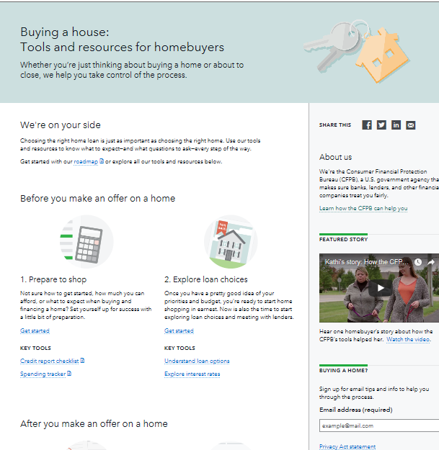
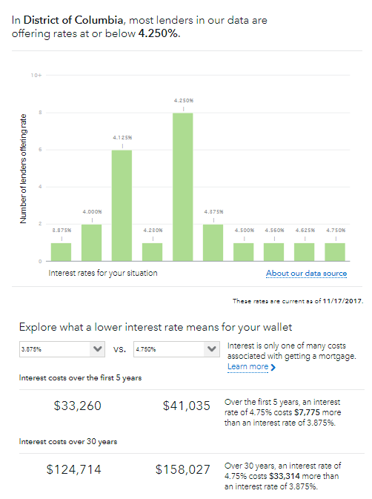
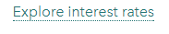
Buying a House
consumerfinance.gov/owning-a-home
15
Notes:
Learn about your loan options: A guide that helps you understand the process of applying for a mortgage.
Check interest rates: A tool that gives you a realistic sense for the range of interest rates you should expect when shopping for a mortgage, so you can know whether you’re getting a good deal.
Understand your closing forms: Form explainers tell you what to look for in your closing documents before signing.
Get ready for closing: A simple checklist to help prepare you for the big day.

Slide 16
Your Home Loan Toolkit
Worksheets, tips, and research starters to help people shop for a home loan
Available in Spanish and English
At consumerfinance.gov: More mortgage help
  Under Consumer Tools, click Mortgages and Ask CFPB
  Under Practitioner Resources, click Free Brochures
16
Notes:
To help you navigate the steps you have to take to get a mortgage, take a look at our booklet, “Your Home Loan Toolkit: A Step-By-Step Guide.” This consumer-friendly booklet can help consumers as they think about, apply for, and close on a mortgage. The toolkit helps consumers calculate how much they can afford for a home, gives questions to ask the lender, and features worksheets and checklists to fill out during the process.

Slide 17
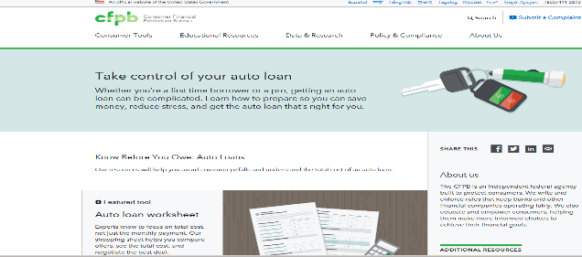
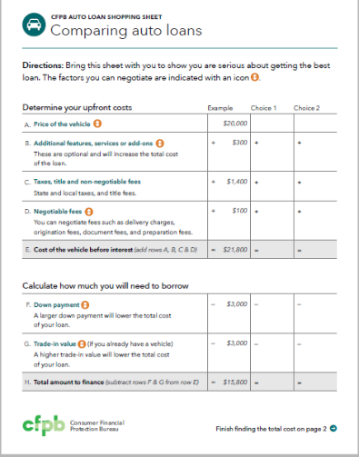
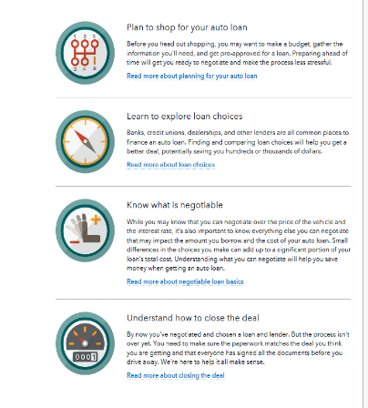
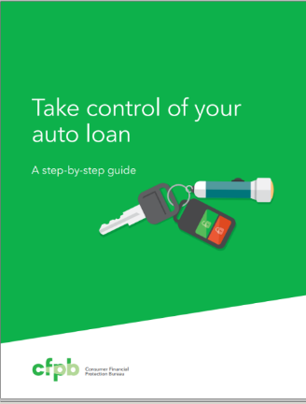
Getting an Auto Loan
Tools and resources to help consumers to:
Shop for an auto loan with as much care as you shop for the vehicle itself
Look beyond the monthly payment and consider total cost to compare and negotiate for financing
“Know before you owe” by spotting financing features that could lead to costly surprises later
Notes:
Plan to shop for your auto loan: suggestions for how to prepare ahead of time.
Learn to explore loan choices: Get a better deal, potentially saving you hundreds or thousands of dollars.
Know what is negotiable: This may impact the amount you borrow and the cost of your auto loan.
Understand how to close the deal: Make sure the paperwork matches the deal and that everyone has signed the documents.

Slide 18

Planning for Retirement
consumerfinance.gov/retirement/before-you-claim
Easy to use, interactive tool
Three simple steps to help consumers navigate their Social Security claiming decision
Optimized for mobile use
Created with the support of SSA
Available in Spanish
Notes:
Note: duplicate of slide 18 – including in OA section in addition to financial education
(cleared content from Intro Kit, Issue Brief)
Planning for Retirement is a interactive tool offered by the Consumer Financial Protection Bureau to help you make an informed decision about when to claim your Social Security benefits. The tool gives you a rough estimate of your monthly benefit and shows how your monthly benefit changes depending on the age at which you start collecting your benefits. The tool also provides claiming tips relevant to your specific situation. The tool is optimized for mobile devices such as smartphones and tablets.

Slide 19

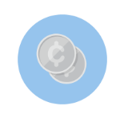

Money as You Grow: for parents and caregivers
consumerfinance.gov/MoneyAsYouGrow
Make it easier for parents and caregivers to put their children on the path to financial well-being in adulthood:
Age-appropriate games and resources
Reinforced by CFPB research on children’s financial development
And more: blog posts, social media outreach, and e-mail
    Developing executive function
    Building money habits and values
    Practicing money skills and decision-making
Notes:
Read off slide

Slide 20
Financial Education
Money Topic Resource Portal

Slide 21
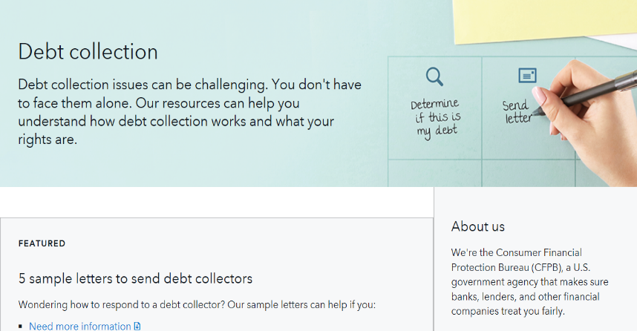
Money Topic Resource Portals – Debt Collection
consumerfinance.gov/consumer-tools/debt-collection/
http://www.consumerfinance.gov/consumer-tools/everyone-has-a-story/debt-collection/
Notes:
The first money topic resource portal (Debt Collection) launched on Jan. 12, 2017.
Debt collection issues can be challenging. You don’t have to face them alone. Our resources can help.
The portal provides general information about the laws that limit what debt collectors can say or do If you are contacted. It offers links to content that describes how a debt collector cannot:
Call repeatedly
Harass or abuse you
Contact you at an unreasonable time (before 8 a.m. or after 9 p.m.)
The portal also covers how you can respond to a debt collector
There are different ways to respond appropriately when a debt collector contacts you. Depending on your situation, we have information that can help if you:
Need more information.
Do not owe the debt.
Want the debt collector to stop contacting you while you dispute the debt and more.
THE INFORMATION ON THE PORTAL ALSO ENCOURAGES PEOPLE TO TALK TO DEBT COLLECTORS. THE DEBT DOESN’T GO AWAY IF THE CONSUMER IGNORES IT. ANY TALKING WITH THE COLLECTOR MAY LEAD TO MORE INFORAMTION ABOU THE DEBT OR DISCUSSIONS ABOUT A PAYMENT PLAN.

Slide 22
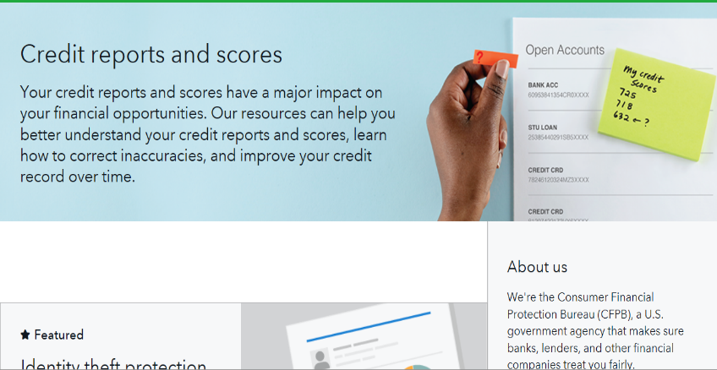
Money Topic Resource Portals – Credit Reports and Scores
consumerfinance.gov/consumer-tools/credit-reports-and-scores/
http://www.consumerfinance.gov/consumer-tools/everyone-has-a-story/debt-collection/
Notes:
CFPB launched the Credit reports and scores page in March 2017 to help bring everything you need to know about your credit reports and scores into one place.
It’s designed to be both a primer for financial newcomers and a place to get information about how you can fix errors.
This page provides an overview of what a credit report is, how to get it, how to make sure it is accurate, how to correct any errors, and how you can build your credit to improve your credit score.
There are several print resources included in the portal, such as sample letters that you can share with furnishers and credit reporting companies to correct errors on your credit reports.

Slide 23
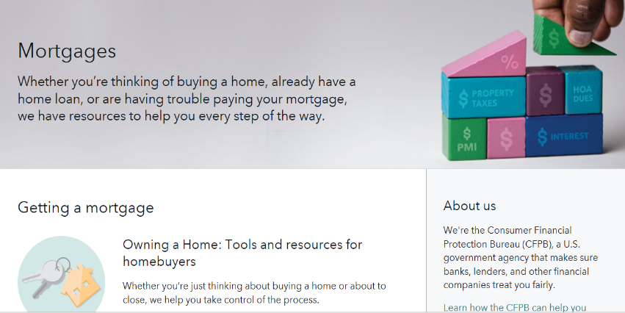
Money Topic Resource Portals – Mortgages
consumerfinance.gov/consumer-tools/mortgages/
http://www.consumerfinance.gov/consumer-tools/everyone-has-a-story/debt-collection/
Notes:
Buying a home is one of the biggest financial decisions you may make in your lifetime. Whether you’re thinking of buying a home, already have a home loan, or are having trouble paying your mortgage, we have resources to help you every step of the way. Our tools and resources can help know what to expect—and what questions to ask—every step of the way.
Our mortgage servicing resources can help you:
Understand your monthly mortgage statement
Know why your mortgage payment might change
Find a HUD-approved housing counselor
Learn how to get information or dispute an error about your mortgage
Find out how to cancel your private mortgage insurance

Slide 24
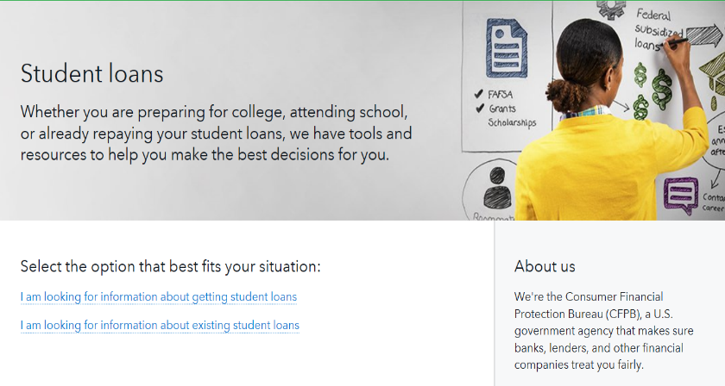
Money Topic Resource Portals – Student Loans
consumerfinance.gov/consumer-tools/student-loans/
http://www.consumerfinance.gov/consumer-tools/everyone-has-a-story/debt-collection/
Notes:
Don't know how much to borrow? Grants and scholarships don't cover the cost of attendance?
Whether you're preparing for college, attending school, or already repaying your student loans, the Consumer Financial Protection Bureau website has tools and resources to help you navigate common issues with student loans.
Our resources about servicing student loans can help you:
Find out the balance of your student loans
Determine what to do if you can't afford your student loan payment. There are ways to reduce your payment so that you can pay and protect your credit report.
Understand consolidation and refinancing options
Learn how to change your student loan repayment plan

Slide 25
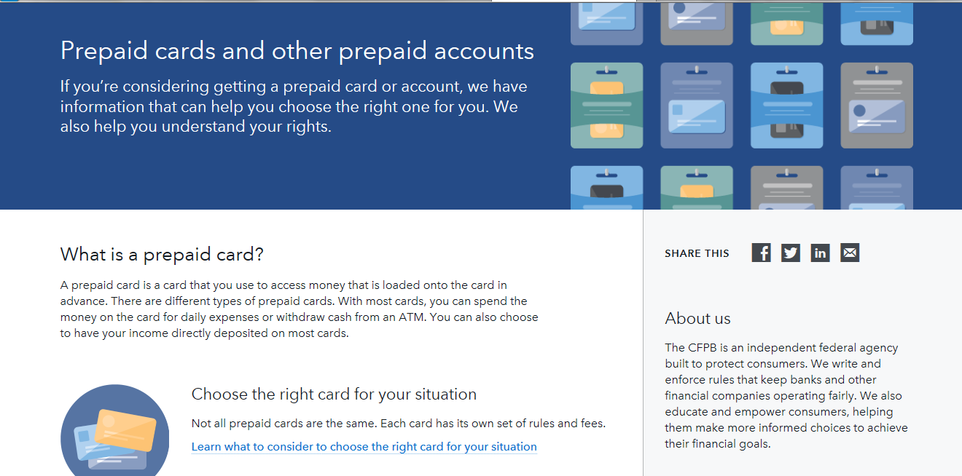
Money Topic Resource Portals – Prepaid Cards
consumerfinance.gov/consumer-tools/prepaid-cards/
http://www.consumerfinance.gov/consumer-tools/everyone-has-a-story/debt-collection/
Notes:
The CFPB’s prepaid consumer tools page provides visitors with the information they can use to help them choose a right prepaid account for their situation. This resource also provides information about consumer’s rights, and helps consumers understand the various fees to maintain prepaid accounts, make purchases and withdrawals.

Slide 26
Financial Education
Collaborative Initiatives

Slide 27
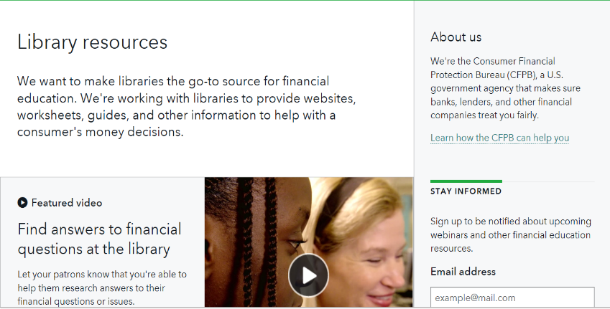
CFPB Community Financial Education Project
Make libraries the go-to resource for financial education in every community
consumerfinance.gov/library-resources
27
Notes:
As of December 2017, we have over 1,600 participating library locations across the country.
Why Libraries:
Cover virtually every community in the U.S.
There were 170.6 million registered borrowers across all public libraries.
1.5 billion in-person visits, equivalent of 4.1 million visits each day.
On average, Americans visited a public library 5.3 times per year.
Attendance at programs conducted in libraries are increasing (37.6% from FY2004 to FY2012) (despite declining budgets, operating revenue, service hours, and staffing).
An important resource for parents and low- and moderate-income households.
In one year, 19 million (25 percent) of all public access users logged on at their public library for commercial needs or to manage their personal finances.

Slide 28
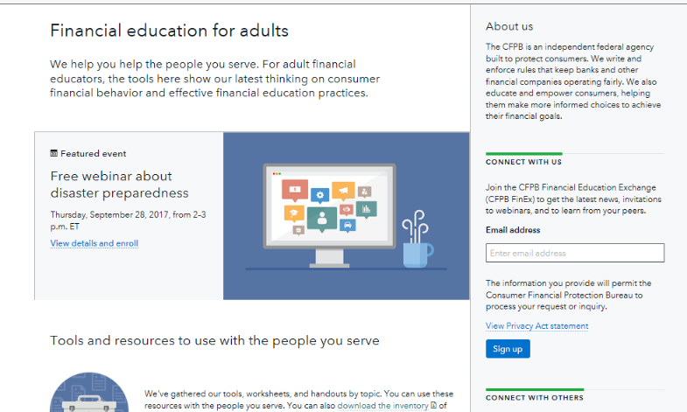
Resources for financial educators webpage
Find it at consumerfinance.gov/adult-financial-education
Notes:
Provides a screen shot of the website along with the web address for the site.

Slide 29

CFPB Financial Education Exchange (CFPB FinEx)
CFPB FinEx: an online and in-person opportunity to access CPFB tools and resources, and connect with the CPFB and your peers engaged in financial education.
Our goal is to help you improve the financial well-being of the people you serve.
Learn
Find the latest CFPB research, tools, and resources for financial educators
Take the CFPB FinEx Pledge to use our tools and resources and provide your feedback
Join webinars on new research findings
Receive e-newsletters
Attend a convening in your area
See CFPB survey results on what’s working
Pledge
Connect
To sign up, email CFPB_FinEx@cfpb.gov
Notes:
Read from slide

Slide 30
Financial Education
Resources for Newcomers

Slide 31
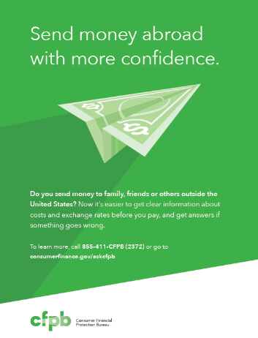
Remittance transfer rule
To help consumers who sends money out of the US:
Informational materials
Consumer summary of the rule
Fact sheet about the rule
Q&As on money transfers in Ask CFPB
31
Notes:
Federal law and rules provide consumer protections for remittance transfers. Through clear, upfront information in several languages, this information will help educate and empower those consumers who send international money transfers.”
You may order: Posters, fliers, factsheets, brochures to help build awareness of the rule to consumers who use international transfers.
These resources are available in Spanish, Chinese, French-Creole, Tagalog
GIVE THE ORDER LINK HERE:

Slide 32
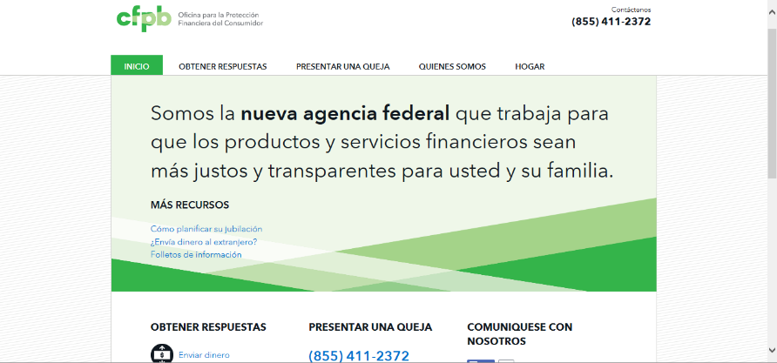
CFPB en Español
consumerfinance.gov/es
32
Notes:
CFPB website. Recognizing the need for Spanish language internet resources, the Bureau launched a website that provides Spanish-speaking consumers a unique portal to the Bureau’s most-used consumer resources available in Spanish. The consumer-focused website includes the following components:
“Ask CFPB” content in Spanish, an interactive online tool that gives consumers answers to questions about financial products and services;
A consumer complaints page that highlights the complaint process and the phone number to submit a complaint in Spanish;
An About Us page that features a Spanish-language video with introductory content about the CFPB;
A Hogar (Home) page that offers informational documents that describe how the Bureau protects consumers in search of a mortgage and those who already own a home;
Planning for Retirement when to claim Social Security tool in Spanish;
A Remittance page highlighting information about disclosure and protections;
Our print publications in Spanish;
An Everyone has a Story video, featuring a Spanish-speaking consumer in Puerto Rico who got help from the Bureau with a credit issue.
The website was created using responsive design, meaning it is optimized for use on mobile devices as well as on computers in order to better serve all consumers. Officially launched in May 2013, the website is available at consumerfinance.gov/es/.

Slide 33
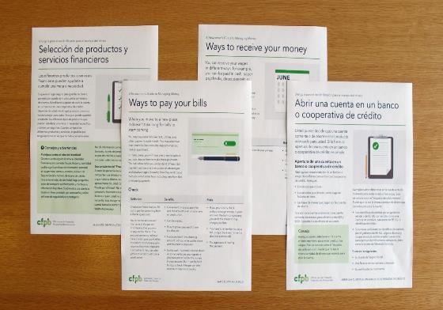
Newcomers Guides to Managing Money
http://www.consumerfinance.gov/about-us/blog/the-newcomers-guides-to-managing-money/
Provide recent immigrants with straightforward information about basic money decisions.
Notes:
According to studies, people with limited English proficiency may be more likely to fall prey to frauds and schemes, and it can be harder to manage money on a day-to-day basis. That’s why we’ve developed the Newcomer’s Guides to Managing Money to provide recent immigrants with straightforward information about basic money decisions.
Each guide features short tips to help new immigrants, and OTHER people who may be new to the U.S. banking system, avoid financial pitfalls. The guides also include information on how to submit a complaint in the event of problem with a financial product or service.

Slide 34
Financial Education
Publications

Slide 35
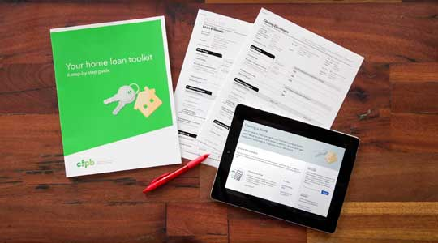
Publications
http://promotions.usa.gov/cfpbpubs.html
The CFPB has free financial education materials in English and many other languages
Available for bulk ordering
Notes:
EXTENSIVE AND FREE FINANCIAL EDUCATION PUBLICATIONS IN ENGLISH
Multilingual publications. The CFPB offers free financial education materials that can be downloaded or ordered in bulk. Selected materials are available in Spanish, Haitian Creole, Mandarin, Korean, Vietnamese, French and Tagalog.
Glossary of financial terms (Spanish and Chinese). The Bureau is also publically sharing glossaries of translated financial terms as a resource tool. Stakeholders that may be interested in using this tool include, but are certainly not limited to, financial educators, government agencies, financial service providers and other organizations serving LEP consumers.

Slide 36
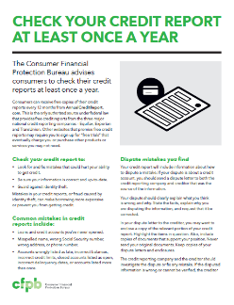
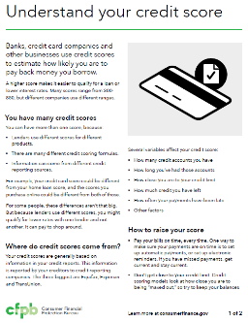
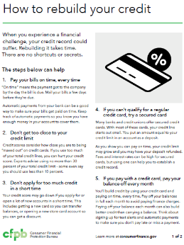
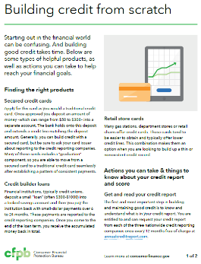
Print resources on credit scores and reports

Slide 37
Open Score Company List
https://www.consumerfinance.gov/about-us/blog/check-our-new-list-see-if-your-credit-card-offers-you-free-access-one-your-credit-scores/
Notes:
The document includes a list of the companies that responded to a notice published in spring 2017.
Only credit card issuers that responded to a notice in the Federal Register are included in the list, but other issuers also may offer this service.
In the document we have also provided links to the comments submitted by each company. The company comments which provide additional information on how that company offers this service. We encourage customers to check this information, or to ask one or more companies that they do business with if they offer access to a free credit score, and if so whether there are any conditions to that offer.

Slide 38
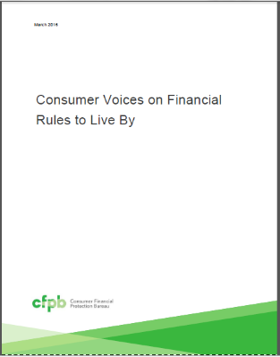
Financial Rules to Live By
Many consumers know about common financial rules of thumb.
Many are frustrated by what they see as unrealistic goals stated in common rules, as they struggle with competing priorities across their financial lives.
There is a sense that financial rules cannot be applied equally to all people in all circumstances.
Many commonly held rules are too broad or ill-defined to offer clear guidance to everyone.
A promising strategy is to help consumers develop their own financial rules of thumb customized to their personal situation -- “financial rules to live by.”
Find it at consumerfinance.gov/adult-financial-education

Slide 39
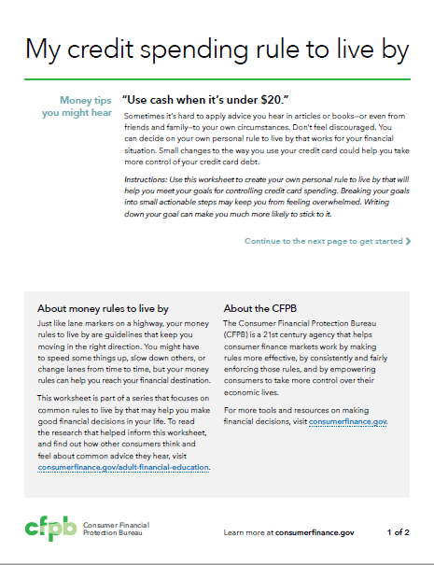
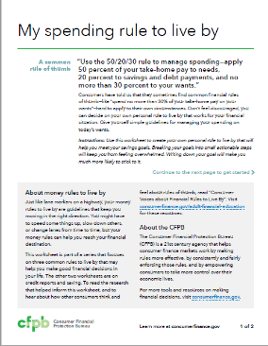
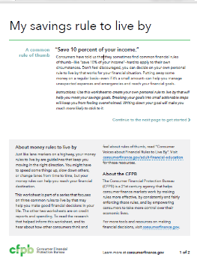
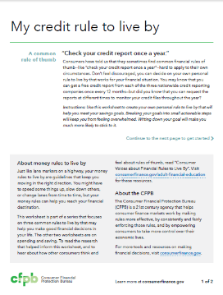
Rules to Live By Consumer Worksheets
Find it at consumerfinance.gov/adult-financial-education

Slide 40
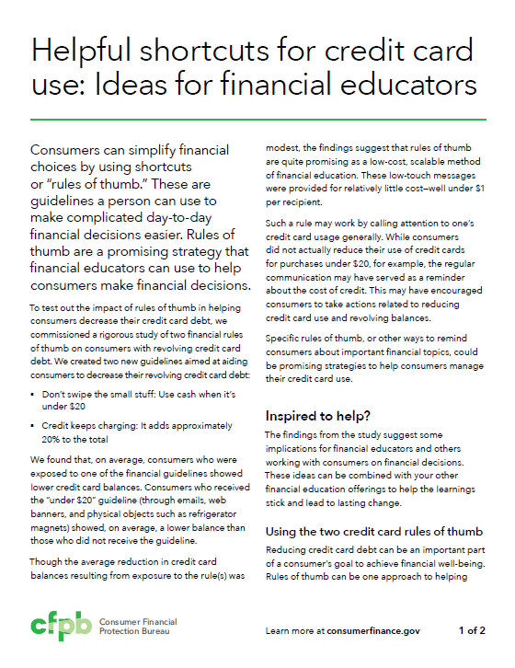
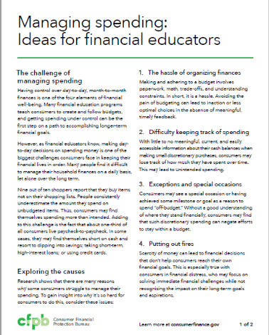
Managing spending and credit resources
Find it at consumerfinance.gov/adult-financial-education

Slide 41
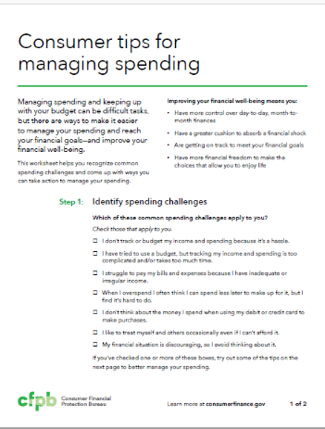
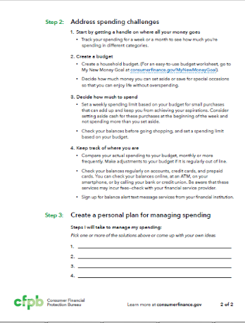
Consumer worksheet on managing spending
Find it at consumerfinance.gov/adult-financial-education

Slide 42
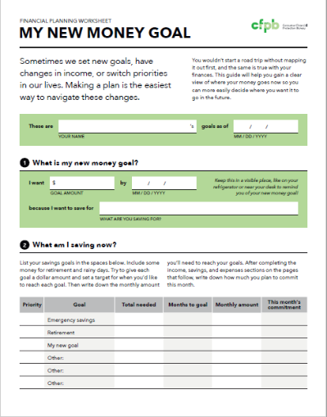
My New Money Goal worksheet

Slide 43
Financial Well-Being

Slide 44

What is financial well-being?
A state of being reflecting a person’s ability to meet current and ongoing financial obligations, feel secure in their financial future, and make choices that allow enjoyment of life.
Present
Future
Control over your
day-to-day, month-to-month finances
Capacity to absorb a
financial shock
Security
Freedom of choice
Financial freedom to make choices to enjoy life
On track to meet your financial goals
Notes:
[slide cleared many times. TPs taken from cleared report]
A foundational step in providing evidence DATA of what works in financial education is knowing how to define and measure success. A growing consensus in the field has recognized that financial education should go beyond simply helping individuals acquire financial facts and actually equip people to act on that knowledge, and that the ultimate goal for financial capability efforts should be improved financial well-being.
[This measure is consistent with the guiding vision of FLEC’s national strategy of achieving “sustained financial well-being for all individuals and families in the United States.” This vision is also consistent with that of the Organization for Economic Co-operation and Development’s (OECD’s) International Network on Financial Education (INFE), in which CFPB participates, which describes the ultimate goal of financial literacy as “individual financial well-being.”]
Because financial well-being had not been previously defined in this context, the CFPB set out to create a standard, comprehensive definition of financial well-being from the consumer perspective that would be relevant across a range of individual circumstances.
To develop this definition, CFPB conducted a three-pronged research approach consisting of: (1) literature-based research; (2) qualitative research that included in-depth interviews with 59 adult consumers and 30 financial practitioners; and (3) consultation with experts.
From these research activities we learned that an individual’s financial well-being corresponds to the extent to which the individual feels that he or she: (1) has control over day-to-day and month-to-month finances; (2) has the capacity to absorb a financial shock; (3) is on track to meet his or her financial goals; and (4) has the financial freedom to make the choices that allow one to enjoy life. Although specific goals and vision of the good life vary from person to person, these four elements reflect two common and consistent themes: security and freedom of choice, in the present and for the future, as summarized in the figure.

Slide 45
The CFPB Financial Well-Being Scale
Questions | Response Options
How well does this statement describe you or your situation? I could handle a major unexpected expense I am securing my financial future Because of my money situation, I feel like I will never have the things I want in life I can enjoy life because of the way I’m managing my money I am just getting by financially I am concerned that the money I have or will save won’t last | Describes me completely Describes me very well Describes me somewhat Describes me very little Does not describe me at all
How often does this statement apply to you? Giving a gift for a wedding, birthday or other occasion would put a strain on my finances for the month I have money left over at the end of the month I am behind with my finances My finances control my life | Always Often Sometimes Rarely Never
Notes:
[slide cleared many times. TPs taken from cleared report]
With an evidence-based, consumer-driven definition of financial well-being in place, CFPB proceeded to the next phase of this work: determining how to measure it. With the support of a number of experts and using state-of-the-art methods, we developed, tested and validated a financial well-being scale. A scale is an instrument, made up of multiple questions or “items,” that together yield a composite measure of something that is nuanced or challenging to observe directly, such as an attitude or ability. A scale is the natural choice to measure the inherently subjective concept of financial well-being.
The CFPB Financial Well-Being Scale consists of 10 items. An individual’s responses to each of the 10 items in the scale are converted into a single score. The CFPB Financial Well-Being Scale allows financial educators and researchers to accurately and consistently quantify the extent to which U.S. adults’ financial situations and the financial capability they have developed have provided them with financial security and freedom of choice. It provides a common metric that allows an apples-to-apples comparison of financial well-being across individuals. It also can be used to assess someone’s current state of financial well-being, to track his or her progress over time, and to understand how various factors, including financial education approaches, affect financial well-being.
[Background info, if needed: The process for developing the CFPB Financial Well-Being Scale included: (1) Cognitive interviews to ensure that people understand the questions and what they are designed to ask; (2) Psychometric analyses of responses provided by more than 10,000 U.S. adults to create the scale model, narrow down the items in the final scale, and assess the reliability of the measure; and (3) Using validation questions in the surveys to check for content and criterion-related validity. The statistical analysis used to develop the scale and scoring procedures was conducted by Vector Psychometric Group using Item Response Theory (IRT) methods. For more information on the development of the scale, see CFPB Financial Well-Being Scale: Scale Development Technical Report, available at consumerfinance.gov/data-research/research-reports/financial-well-being-technical-report]

Slide 46
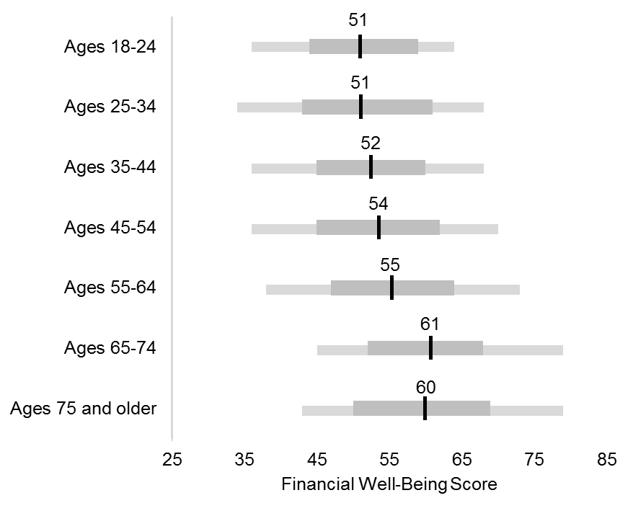
Financial well-being score by age
Notes:
[cleared for 10/26/17 FinEx Webinar]
On average, younger adults (those ages 34 and younger) tend to have the lowest financial well-being with an average score of 51, while older adults (those 65 and over) have the highest financial well-being. While financial well-being appears to be positively associated with age, there is wide variation in the level of financial well-being within all age groups.
Adults aged 65-74 have an average financial well-being score of 61 and those ages 75 and older have an average score of 60. These scores are not statistically different from one another.
There are many possible factors that may contribute to these results. The positive association between financial well-being and age, for instance, could be due to changes in financial factors that correspond to the life course, such as higher incomes that come with longer tenure in the job market for those who are still working, increased asset accumulation over time, or the security conferred by access to social benefits such as Social Security retirement benefits and Medicare.
Average differences in financial well-being by age could also be due to differences in expectations, life goals, and priorities at different life stages that also may affect financial well-being. Regardless of the underlying cause, it is an important finding to keep in mind, as other observed associations between financial well-being and other factors may be, at least in part, due to correlations with life stage. For example, the associations between financial well-being and Social Security receipt, financially supporting children, and employment status may reflect underlying relationships with age. Furthermore, while the data analyzed for this report provide only a snapshot view of the relationship between age and financial well-being, these results also raise many questions that may be better examined with longitudinal data.

Slide 47
Older Americans

Slide 48


Office for Older Americans
We develop initiatives, tools, and resources to:
help protect older consumers from financial harm
help older consumers make sound financial decisions as they age
Learn more about us at consumerfinance.gov/older-americans
Notes:
Updated 11/29/2017

Slide 49
A growing population
The number of older consumers 62+ is expected to grow from 60.5 million in 2016 to 96.7 million in 2050.
Source: Census Bureau, National Population Projections
Notes:
New Slide added 11/17/2017

Slide 50
Many consumers have not saved enough for retirement
Percent of consumers with a projected savings shortfall by generation, 2014
Source: EBRI 2014 Retirement Security Projection Model
Notes:
New slide 11/17/2017

Slide 51
Older households are carrying debt into their later years
Source: Fed. Reserve Board, 2016 Survey of Consumer Finances
Notes:
Fed Reserve Board, Survey of Consumer Finances, page 837
https://www.federalreserve.gov/econres/files/BulletinCharts.pdf

Slide 52

Money Smart for Older Adults
  An awareness program developed in collaboration with the FDIC.
  Content on common issues facing seniors, including how to identify a potential scam or fraud and other forms of exploitation
  Instructor-led curriculum
  Resource Guide available in
  bulk at no charge
  Content updated March 2017
  Available in English and Spanish
Notes:
Updated graphic 11/29/2017

Slide 53
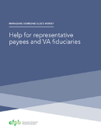
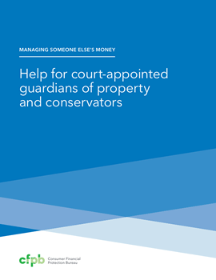
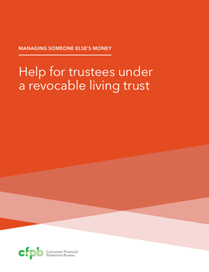

Managing Someone Else’s Money guides
Help for financial caregivers handling the finances for a family member or friend who is incapacitated
Guides for four common types of financial caregivers:
  Agents under a Power of attorney
  Guardians and conservators
  Trustees
  Social Security and Department of Veterans Affairs (VA) representatives
Includes tips on protecting assets from fraud and scams.
Available in English and Spanish
Notes:
Updated 11/29/2017

Slide 54
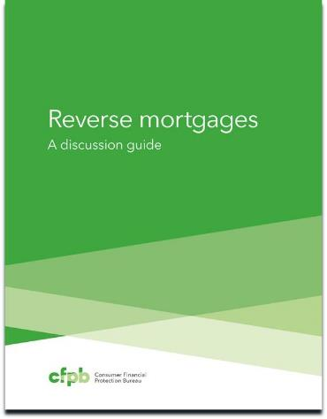
Reverse Mortgage Resources
  Discussion Guide - a primer to help homeowners considering a reverse mortgage
  Video - a short video that provides key information about the features of a reverse mortgage
  Considering a Reverse Mortgage Guide - Important questions to ask before talking to a housing counselor about reverse mortgage options and alternatives
Notes:
New slide added 11/29/2017

Slide 55
Supporting elder financial exploitation prevention and response networks
We studied the benefits of community networks nationwide that bring together key partners like law enforcement, financial institutions, and adult protective services to protect seniors from financial exploitation.
We released a report based on this study, Fighting Elder Financial Exploitation through Community Networks.
We embarked on an outreach initiative called the Community Protection Networks Project (CPNP) to “seed” the formation of new networks where none exist and help those that are functioning to grow in size or scope and/or enhance their impact.
Learn more at: consumerfinance.gov/elder-protection-networks
Notes:
Updated 11/29/2017

Slide 56
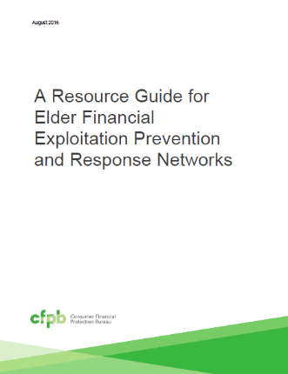
A resource guide for elder financial exploitation prevention and response networks
Tips and resources on:
Steps for starting a network
Sustainability
Traits of successful network coordinators
Organizing effective meetings
Education and case review
Notes:
Added 11/29/2017
The resource guide provides tips and resources on:
Steps for starting a network
Funding and sustainability
Traits of successful network coordinators
Organizing effective meetings
Education and case review
In our resource guide we highlight two resources that may be of interest to you, which I will discuss in further detail:

Slide 57
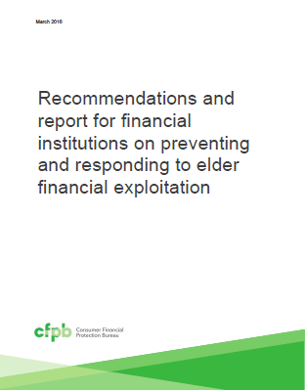
Working with financial institutions to protect older account holders
Voluntary recommendations for financial institutions:
Train staff to recognize abuse
Use fraud detection technologies
Offer age-friendly services
Report suspicious activity to authorities
Notes:
Updated 11/29/2017
Voluntary recommendations for financial institutions to consider include:
Training staff to recognize abuse: Financial institutions should train employees to prevent, detect, and respond to abuse. Training should cover the warning signs of financial exploitation and appropriate responses to suspicious events.
Using fraud detection technologies: Financial institutions should ensure that their fraud detection systems spot suspicious account activity and products associated with elder fraud risk. This includes using predictive analytics to review account holders’ patterns and explore additional risk factors that may be associated with elder financial exploitation. Some signs of elder fraud risk may not match conventionally accepted patterns of suspicious activity, but nevertheless may be unusual given a particular account holder’s regular behavior.
Offering age-friendly services: Banks and credit unions should enhance protections for seniors, such as encouraging consumers to plan for incapacity. They can also offer age-friendly account features such as opt-in limits on cash withdrawals or geographic transactions, alerts for specific account activity, and offer view-only access for authorized third parties. And they can enable older consumers to provide advance consent to share account information with a trusted relative or friend when the consumer appears to be at risk.
Reporting suspicious activity to authorities: Financial institutions should promptly report suspected exploitation to relevant federal, state, and local authorities, regardless of whether reporting is mandatory. Banks and credit unions can work closely with local Adult Protective Services and law enforcement to enhance prevention and response efforts, including expediting document requests and providing them at no charge.

Slide 58
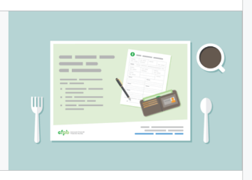
Fraud Prevention Placemats
  Paper placemats include information to help older adults avoid common financial scams.
  Placemats can be used at group meal sites, or by community or faith-based organizations, financial institutions, and other groups in a variety of ways.
  We offer a companion resource with tips and information to reinforce the messages on the placemats.
  Placemats are free to download or order in bulk.
  Visit www.consumerfinance.gov/placemats
Notes:
New slide added 11/29/2017

Slide 59

Tips and advice for older consumers
CFPB has consumer advisories on:
Asset recovery scams
Co-signing student loans
Taking a pension advance
Dealing with medical debt
Planning for diminished capacity
Recognizing misleading claims in reverse mortgage advertising
Responding to debt collectors’ threats of garnishing Social Security benefits
Notes:
No change

Slide 60
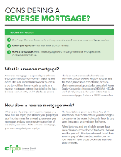
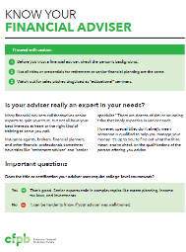
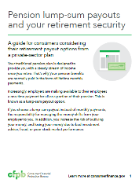
Guides to help older consumers make informed financial decisions
The guides cover topics such as:
  Reverse mortgages
  Financial advisers
  Pension lump-sum offers
The guides list important questions to ask and where to go for help.
Notes:
Updated 11/29/2017

Slide 61
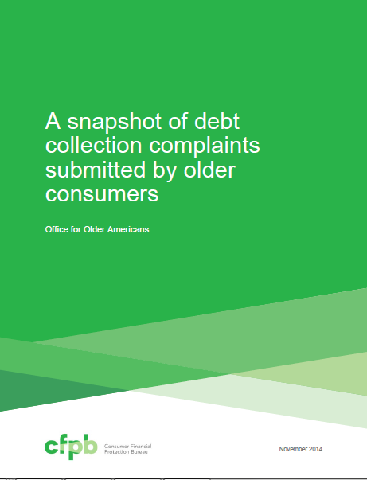
Older consumer complaints report snapshots
Summarizes complaints submitted to the CFPB by older consumers on:
  mortgages,
  reverse mortgages,
  student loan debt, and
  debt collection.
Notes:
Updated slide 11/30/2017

Slide 62
Planning for Retirement
consumerfinance.gov/retirement/before-you-claim
Easy to use, interactive tool
Three simple steps to help consumers navigate their Social Security claiming decision
Optimized for mobile use
Created with the support of SSA
Available in English and Spanish
Notes:
Note: duplicate of slide 18 – including in OA section in addition to financial education
(cleared content from Promo Kit, Issue Brief)
Planning for Retirement is a interactive tool of the Consumer Financial Protection Bureau to help you make an informed decision about when to claim your Social Security benefits. The tool gives you a rough estimate of your monthly benefit and shows how your monthly benefit changes depending on the age at which you start collecting your benefits. The tool also provides claiming tips relevant to your specific situation. The tool is optimized for mobile devices such as smartphones and tablets.

Slide 63
Listening to consumers
Helping consumers

Slide 64
How we help
Individual assistance
Market-wide information
We turn complaints into action. We work to get a response to complaints – generally within 15 days
Every complaint provides insight into problems consumers are experiencing, allowing us to improve the marketplace
64
Notes:
Why submit a complaint? First, we try to make sure that for each complaint we receive consumers get a response from the company or are connected to another resource for assistance. We can’t solve every problem, but we make sure each consumer's voice is heard. Second, complaints help us inform our work and improve the transparency and efficiency of the market overall. Complaints are a window into the consumer experience.

Slide 65
Complaints we accept now
65
Notes:
We’ve added capacity to handle complaint over time.

Slide 66
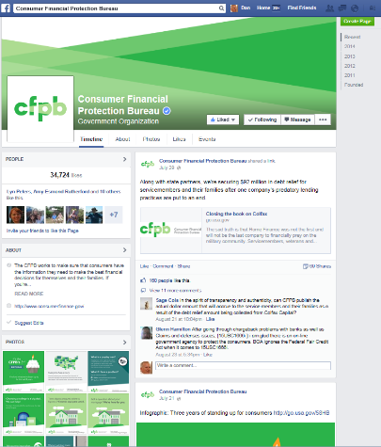
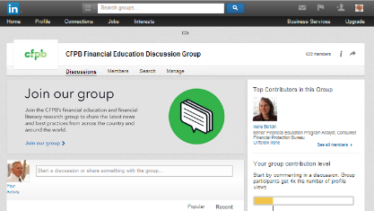

Social media
facebook.com/cfpb
LinkedIn
twitter.com/CFPB
66

Slide 67
Questions?

