Slide 1
Elder Financial Exploitation Prevention and Response Networks
Jenefer Duane, Sr. Program Analyst
Tami Sieckman, Outreach Coordinator
Office for Older Americans
April 2, 2018
Notes:
Stock presentation copy - previously cleared for Tennessee presentation September 25, 2017

Slide 2
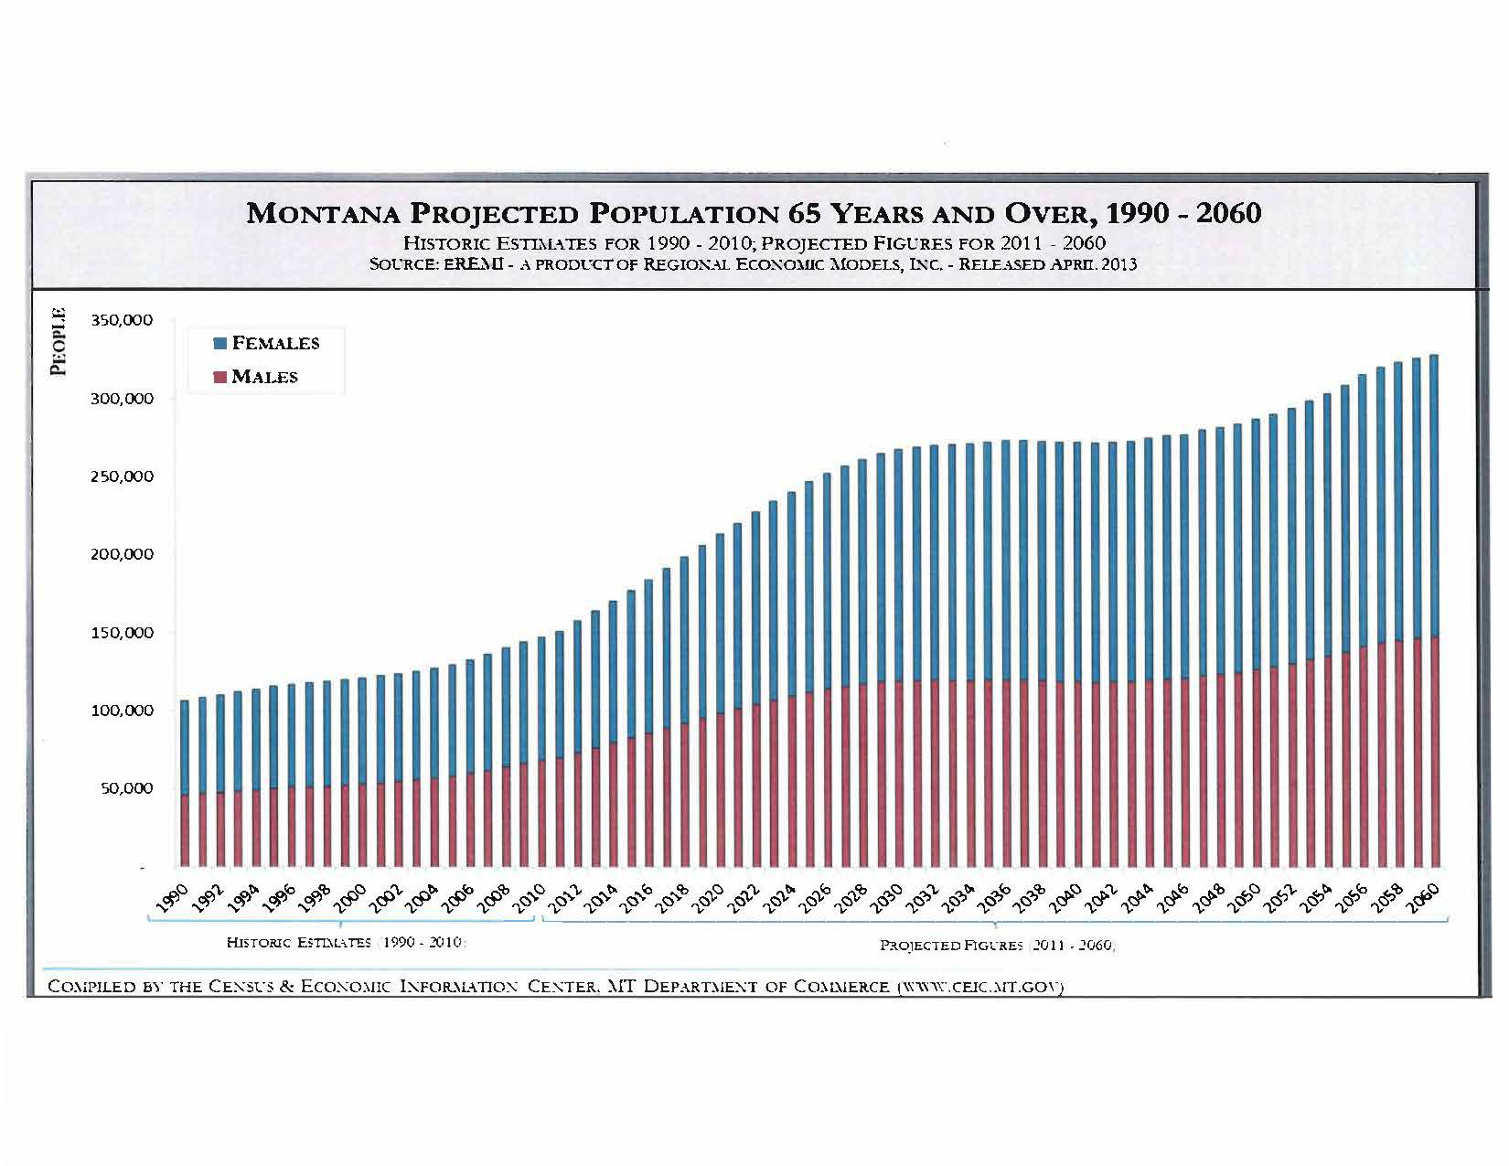

Slide 3
Disclaimer
This presentation is being made by a Consumer Financial Protection Bureau representative on behalf of the Bureau. It does not constitute legal interpretation, guidance or advice of the Consumer Financial Protection Bureau. Any opinions or views stated by the presenter are the presenter’s own and may not represent the Bureau’s views.
Notes:
Stock presentation copy - previously cleared for Tennessee presentation September 25, 2017
Today, we will share with you our work, and our experiences as experts in this area. And, as such, our opinions may not represent the Bureau’s views.

Slide 4
CFPB’s Statutory Objectives - DFA
OBJECTIVES. – The Bureau is authorized to exercise its authorities for the purposes of ensuring that, with respect to consumer financial products and services –
Consumers are provided with timely and understandable information to make responsible decisions about financial transactions;
Consumers are protected from unfair, deceptive, or abusive acts and practices and from discrimination;
Outdated, unnecessary, or unduly burdensome regulations are regularly identified and addressed in order to reduce unwarranted regulatory burdens;
Federal consumer financial law is enforced consistently, without regard to the status of a person as a depository institution, in order to promote fair competition; and
Markets for consumer financial products and services operate transparently and efficiently to facilitate access and innovation.
Notes:
DFA – stands for Dodd-Frank Act

Slide 5


Office for Older Americans
We develop initiatives, tools, and resources to:
help protect older consumers from financial harm
help older consumers make sound financial decisions as they age
Learn more about us at consumerfinance.gov/olderamericans
Notes:
Stock slide from CEE 101 deck 3/26/2018
The Dodd Frank Act also created an office for Older Americans within the agency. The office is dedicated the financial security of older consumers (defined as those ages 62 and older) and to the protection of older consumers from unfair, abusive, and deceptive practices.
Today’s presentation describes one of our key initiatives on the creation of new networks, and enhance existing networks’ capacity to address elder financial exploitation.

Slide 6
Study of elder financial protection networks

Slide 7
Supporting elder financial exploitation prevention and response networks
We studied the benefits of community networks nationwide that bring together key partners like law enforcement, financial institutions, and adult protective services to protect seniors from financial exploitation.
We released a report based on this study, Fighting Elder Financial Exploitation through Community Networks.
We embarked on an outreach initiative called the Community Protection Networks Project (CPNP) to “seed” the formation of new networks where none exist and help those that are functioning to grow in size or scope and/or enhance their impact.
Learn more at: consumerfinance.gov/elder-protection-networks
Notes:
Updated 11/29/2017

Slide 8
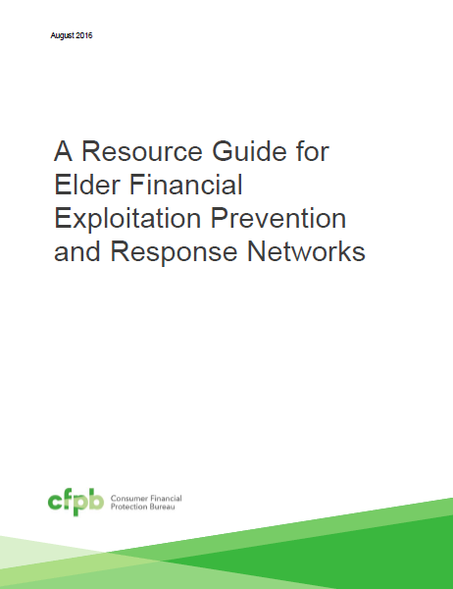
A resource guide for elder financial exploitation prevention and response networks
Tips and resources on:
Steps for starting a network
Sustainability
Traits of successful network coordinators
Organizing effective meetings
Education and case review
Notes:
Added 11/29/2017
The resource guide provides tips and resources on:
Steps for starting a network
Funding and sustainability
Traits of successful network coordinators
Organizing effective meetings
Education and case review
In our resource guide we highlight two resources that may be of interest to you, which I will discuss in further detail:

Slide 9
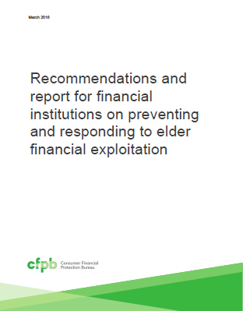
Working with financial institutions to protect older account holders
Voluntary recommendations for financial institutions:
Train staff to recognize abuse
Use fraud detection technologies
Offer age-friendly services
Report suspicious activity to authorities
Notes:
Updated 11/29/2017
Voluntary recommendations for financial institutions to consider include:
Training staff to recognize abuse: Financial institutions should train employees to prevent, detect, and respond to abuse. Training should cover the warning signs of financial exploitation and appropriate responses to suspicious events.
Using fraud detection technologies: Financial institutions should ensure that their fraud detection systems spot suspicious account activity and products associated with elder fraud risk. This includes using predictive analytics to review account holders’ patterns and explore additional risk factors that may be associated with elder financial exploitation. Some signs of elder fraud risk may not match conventionally accepted patterns of suspicious activity, but nevertheless may be unusual given a particular account holder’s regular behavior.
Offering age-friendly services: Banks and credit unions should enhance protections for seniors, such as encouraging consumers to plan for incapacity. They can also offer age-friendly account features such as opt-in limits on cash withdrawals or geographic transactions, alerts for specific account activity, and offer view-only access for authorized third parties. And they can enable older consumers to provide advance consent to share account information with a trusted relative or friend when the consumer appears to be at risk.
Reporting suspicious activity to authorities: Financial institutions should promptly report suspected exploitation to relevant federal, state, and local authorities, regardless of whether reporting is mandatory. Banks and credit unions can work closely with local Adult Protective Services and law enforcement to enhance prevention and response efforts, including expediting document requests and providing them at no charge.

Slide 10
What is a network?
A sustained, and largely voluntary, collaborative effort or partnership that works to prevent, detect, and/or respond to elder financial exploitation.
Notes:
Stock presentation copy - previously cleared for Tennessee presentation September 25, 2017
What are networks? For the purposes of our work-
A network is a sustained, and largely voluntary, collaboration effort or partnership that works to detect, prevent, and/or respond to elder financial exploitation. Financial exploitation is the fraudulent or otherwise illegal, unauthorized, or improper actions by a caregiver, fiduciary, or other individual in which the resources of an older person are used by another for personal profit or gain; or actions that result in depriving an older person of the benefits, resources, belongings, or assets to which they are entitled.
Networks are sustained, because they are not a one-time event or meeting
These efforts are largely voluntary from formation to operation- important distinction from mandates MDTs or similar interagency protocol.
The magnitude and complexity of the problem requires a collaborative community response:
A growing older population - 10,000 people in the U.S. turn 65 every day
Losses estimated to be as much as $36.5 billion
Numerous and constantly changing forms of exploitation
A variety of perpetrators
A number of vulnerability factors - including cognitive decline
Financial exploitation often occurs alongside neglect, physical abuse, sexual assault, and other types of elder abuse.
Financial exploitation has an impact on a number of community stakeholders ranging from financial institutions to social service organizations.

Slide 11
Why study networks?
We had a limited understanding of:
How networks fight elder financial exploitation
Kinds of activities they conduct
Benefits to individuals, professionals and communities
Coverage across the Unites States
Their capacity
Structures they follow
Their membership
The challenges and opportunities for sustainability and replication
Notes:
Stock presentation copy - previously cleared for Tennessee presentation September 25, 2017
Why did we engage in this research?
Existing research is focused on networks that fight elder abuse generally. We had a limited understanding of:
How networks fight elder financial exploitation, and the kinds of activities that they conduct
Their benefits to individuals, professionals and communities
Their coverage across the Unites States, and their capacity
The structures they follow and their membership
The challenges and opportunities for sustainability and replication

Slide 12
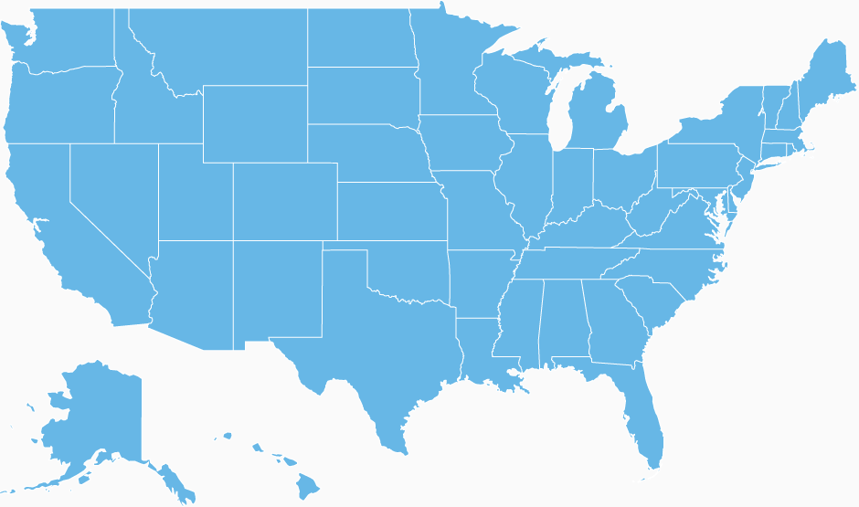
Network study methodology
Literature review
Interviews with experts
In-depth qualitative study of 23 networks
One-on-one interviews & group discussions
Site visits
Analysis of existing lists of networks
County-level analysis
Notes:
Stock presentation copy - previously cleared for Tennessee presentation September 25, 2017
To increase our understanding of how elder financial protection networks can grow and endure, we conducted research nationwide. With the help of the Federal Research Division of the Library of Congress, we attended network meetings and interviewed representatives from 23 elder protection networks and various experts in the field. Our inquiries focused on networks’ objectives, structure, leadership, funding, members, activities and challenges. In addition, we conducted a quantitative analysis to examine networks’ presence in communities across the United States.

Slide 13
Selected findings
Notes:
Here are some key findings…

Slide 14
Networks benefits
For seniors, professionals and communities
Improve response to cases of financial exploitation
Increase reporting of cases
Enhance members’ skills and capacity to address financial exploitation
Improve coordination, including the use of community resources
Notes:
Stock presentation copy - previously cleared for Tennessee presentation September 25, 2017
We found that networks benefit seniors, professionals and their communities in four ways:
Networks improve response to financial exploitation.
The local networks in Cook County, IL and Oklahoma City, OK, for instance, stated that the participation of financial experts, such as forensic accountants and compliance officers from financial institutions, was crucial in case review. The financial experts contribute advice and analysis regarding, among other things, financial transactions, access to needed documentation, and recovery of assets.
In addition, networks help members gain a clear understanding of each other’s roles, policies, resources and limitations. A member from a law enforcement agency in Cook County, IL said, “People get to know each other, you’ve met them, talked to them, know where to go for your victim.” A local network in Fairfield County, OH stated that network collaboration helped speed up processes such as obtaining guardianship orders and emergency orders for placement and to freeze assets.
Networks increase reporting of suspected cases
Many networks located in states with mandatory reporting laws, including Colorado, Hawaii, and California,25 work to raise awareness of their states’ reporting requirements for financial institutions.
They said that their efforts help to embolden seniors in their communities to come forward and report cases, identify other seniors who may be victims of financial exploitation, and help the network’s education efforts by spreading the word.
Network participation enhances members’ skills and ability to address financial exploitation
These experiences provide them with problem-solving skills and knowledge about a variety of topics including how financial products and services work and how financial exploitation interacts with other forms of elder abuse. A local network in Hawaii developed a process to institutionalize their experiences from their case review work through a ‘lessons learned’ survey form. The case review team collects these reports to improve prosecution referrals, care provided to victims, and support for witnesses.
Networks leverage and save community resources
Similarly, network members share training and cross-promotion opportunities. In Pickaway County, OH, for example, the local network was able to use their private sector members’ access to media, billboards, and other vehicles to conduct their educational campaigns. In other networks, staff expertise was shared. The networks in Orange County, CA, Houston, TX, and Cook County, IL, among others, help APS staff, prosecutors and law enforcement by offering free professional services from geriatricians, forensic accountants, compliance officers, and elder law attorneys.

Slide 15
Networks prevalence
891 networks nationwide
Notes:
Stock presentation copy - previously cleared for Tennessee presentation September 25, 2017
We found that networks benefit seniors, professionals and their communities in four ways:
Networks improve response to financial exploitation.
The local networks in Cook County, IL and Oklahoma City, OK, for instance, stated that the participation of financial experts, such as forensic accountants and compliance officers from financial institutions, was crucial in case review. The financial experts contribute advice and analysis regarding, among other things, financial transactions, access to needed documentation, and recovery of assets.
In addition, networks help members gain a clear understanding of each other’s roles, policies, resources and limitations. A member from a law enforcement agency in Cook County, IL said, “People get to know each other, you’ve met them, talked to them, know where to go for your victim.” A local network in Fairfield County, OH stated that network collaboration helped speed up processes such as obtaining guardianship orders and emergency orders for placement and to freeze assets.
Networks increase reporting of suspected cases
Many networks located in states with mandatory reporting laws, including Colorado, Hawaii, and California,25 work to raise awareness of their states’ reporting requirements for financial institutions.
They said that their efforts help to embolden seniors in their communities to come forward and report cases, identify other seniors who may be victims of financial exploitation, and help the network’s education efforts by spreading the word.
Network participation enhances members’ skills and ability to address financial exploitation
These experiences provide them with problem-solving skills and knowledge about a variety of topics including how financial products and services work and how financial exploitation interacts with other forms of elder abuse. A local network in Hawaii developed a process to institutionalize their experiences from their case review work through a ‘lessons learned’ survey form. The case review team collects these reports to improve prosecution referrals, care provided to victims, and support for witnesses.
Networks leverage and save community resources
Similarly, network members share training and cross-promotion opportunities. In Pickaway County, OH, for example, the local network was able to use their private sector members’ access to media, billboards, and other vehicles to conduct their educational campaigns. In other networks, staff expertise was shared. The networks in Orange County, CA, Houston, TX, and Cook County, IL, among others, help APS staff, prosecutors and law enforcement by offering free professional services from geriatricians, forensic accountants, compliance officers, and elder law attorneys.

Slide 16
Networks models
Notes:
Stock presentation copy - previously cleared for Tennessee presentation September 25, 2017
Our study found that networks follow primarily three collaboration models, often have different structures, perform different activities, and are known by a variety of names. Yet two models of collaboration seem to dominate: Triads and innovative network models seen on the chart as “other”. The majority of all networks identified follow these three models of collaboration.
Other networks are often known as elder abuse (prevention) coalitions, task forces and alliances, to name a few.

Slide 17
Triads
Coordinate between law enforcement, elder service professionals, and older community members
Promote crime awareness and prevention
Provide education and training to law enforcement, seniors, caregivers, and professionals
Perform activities involving crime reduction and safety
Notes:
Stock presentation copy - previously cleared for Tennessee presentation September 25, 2017
Triads provide coordination between law enforcement, elder service professionals, and older community members to promote the awareness and prevention of crimes that target older people. Their primary activities include education and training of law enforcement, seniors, caregivers, and professionals involved in serving seniors. They may also perform other activities involving crime reduction and safety.
Increasingly, Triads are engaging in presentations and activities concerning prevention and increased awareness of elder abuse and financial exploitation.
How many of you participate in or are engaged with a network that collaborates with a Triad? (show of hands)

Slide 18
Multi-Disciplinary Teams (MDTs)
Provide resources, consultation, and advice regarding elder abuse cases
Bring together experts from multiple disciplines
Provide education or training to members and the public
Notes:
Stock presentation copy - previously cleared for Tennessee presentation September 25, 2017
Multi-Disciplinary Teams provide agencies, such as APS and law enforcement, with resources, consultation, and advice regarding elder abuse cases. MDTs bring together social service, legal, medical, psychological, and law enforcement experts. While most MDTs are focused on case review activities, some MDTs provide education or training to members and the public. There are also several types of specialized MDT’s. One of the most prevalent focuses specifically on financial exploitation.
How many of you are engaged with a MDT? (show of hands)

Slide 19
Financial Abuse Specialist Teams (FASTs)
A type of specialized MDT focused on financial exploitation.
Provide consultation and support to agencies who investigate cases of elder financial exploitation.
Members are comprised of public agencies but may include private sector experts.
Notes:
Stock presentation copy - previously cleared for Tennessee presentation September 25, 2017
Financial Abuse specialist Teams or (FASTs) are a type of specialized MDT that focuses specifically on financial exploitation.
(FASTs) typically provide consultation and support to agencies, such as APS case workers, law enforcement, and long-term care ombudsmen, who are responding to and investigating cases of elder financial exploitation. Members often are comprised of public agencies but may include private sector experts from the fields of banking, insurance, accounting, law, medicine, and real estate.
How many of you are engaged with a FAST? (show of hands)

Slide 20
Other types of networks
Often known as task forces or coalitions
Focus on elder abuse and elder financial exploitation
Engage in a variety of activities ranging from education to advocacy and including case consultation and review
May focus on abuse of vulnerable adults of all ages
Notes:
Stock presentation copy - previously cleared for Tennessee presentation September 25, 2017
There are many other types of networks organized to fight elder abuse and elder financial abuse.
Twenty-two percent of the networks working on elder abuse are not MDTs or Triads. These other networks, coalitions, and task forces engage in a variety of activities ranging from education to advocacy. Some of these networks also work on case consultation and review similar to financial abuse specialist teams (FASTs). Some of them may also focus on abuse of vulnerable adults of all ages (such as younger adults with disabilities).
How many of you are engaged with another type of network? (show of hands)

Slide 21
Networks issues
Most include financial exploitation as part of a broader focus on elder abuse
Notes:
Stock presentation copy - previously cleared for Tennessee presentation September 25, 2017
Most networks focus on protecting seniors from financial exploitation as part of a broader mission to fight elder abuse, though some do have a singular focus on financial exploitation. According to our analysis, 837 (94 percent) appear to have a broader focus on protecting seniors from all types of abuse, and 54 (or 6 percent) appear to be exclusively focused on financial exploitation.
How many of you are engaged with a network that focuses on financial exploitation? (show of hands)
On financial exploitation and part of a broader approach to elder abuse? (show of hands)

Slide 22
Networks coverage
Notes:
Stock presentation copy - previously cleared for Tennessee presentation September 25, 2017
The benefits of networks and the variety of possible models are shown by the hundreds of communities where they exist. Nonetheless, large areas of the country do not currently have a network and are ripe areas for expansion of this beneficial approach. We identified many localities and regions throughout the country without networks. Only 25 percent of the 3,143 counties in the U.S. have a known network working on elder abuse issues and only 2 percent of all counties appear to have a network focused exclusively on financial exploitation. As the older population continues to grow throughout the country, there is ample opportunity to create many more new networks to respond to the growing problem of elder financial exploitation.

Slide 23
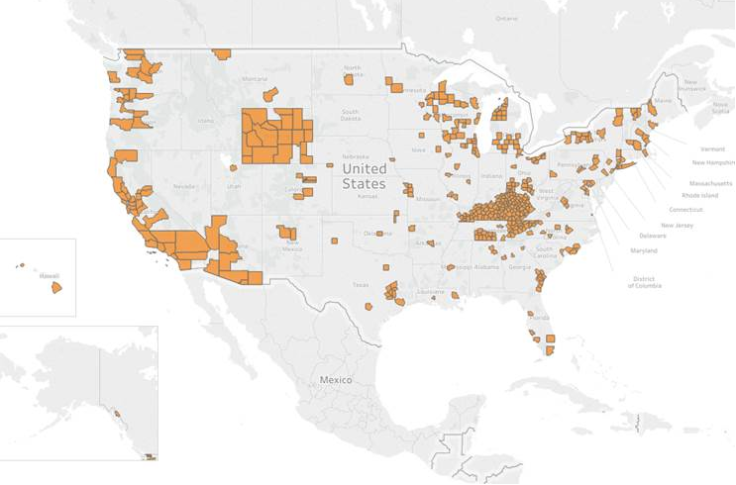
Networks coverage
Notes:
Stock presentation copy - previously cleared for Tennessee presentation September 25, 2017
In most states non-Triads tend to exist in cities. In some states, MDTs and other networks provide statewide coverage.

Slide 24
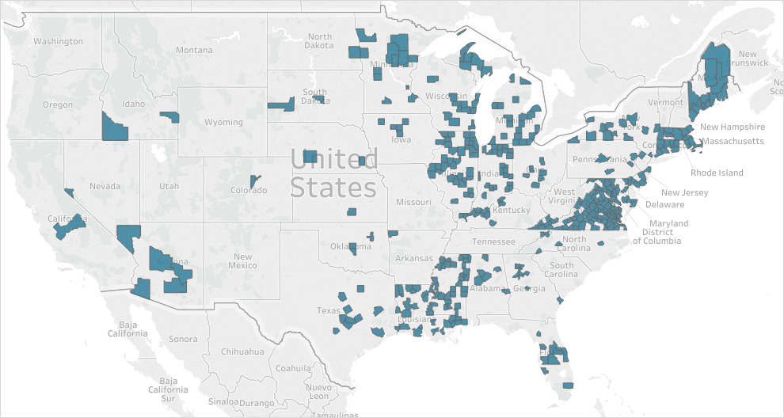
Triads coverage
Notes:
Stock presentation copy - previously cleared for Tennessee presentation September 25, 2017
When we remove the other networks, as we can see, Triads provide significant geographic coverage. In some states like Maine, Virginia, Connecticut, almost full statewide coverage is provided by Triads.

Slide 25
Networks locations
Notes:
Stock presentation copy - previously cleared for Tennessee presentation September 25, 2017
Networks, including those exclusively focused on financial exploitation, tend to operate in densely populated counties. These counties have the largest number of residents age 65 and over and elders of diverse ethnic and racial backgrounds. Our analysis shows that the 20 counties with the largest number of people age 65 and over have at least one network, and half of them have two or more. Over half of these counties also have a network focused exclusively on financial exploitation.

Slide 26
Other key findings
Most common ways networks fight financial exploitation are through community education, professional training, and case review.
Networks share some common features and needs, including a resourceful coordinator, start-up funding, technical assistance support, and long-term funding and staffing.
Most networks do not require significant funding to start up or continue functioning.
Existing networks are often the catalyst for new networks; effective networks seek opportunities for replication and ensuring statewide coverage.
Notes:
Stock presentation copy - previously cleared for Tennessee presentation September 25, 2017
We also found that:
Most common ways networks fight financial exploitation are through community education, professional training, and case review.
Networks share some common features and needs, including a resourceful coordinator, start-up funding, technical assistance support, and long-term funding and staffing.
Most networks do not require significant funding to start up or continue functioning.
Existing networks are often the catalyst for new networks; effective networks seek opportunities for replication and ensuring statewide coverage.

Slide 27
Recommendations and Resources

Slide 28
Coverage and focus
Create networks in communities where they do not currently exist, especially those with a large number of older people.
Seek to expand coverage into rural areas by creating regional networks through which resources can be shared, and by using teleconferencing and videoconferencing in lieu of travel when necessary.
Notes:
Stock presentation copy - previously cleared for Tennessee presentation September 25, 2017
Professionals working with or serving older adults should create networks in communities where they do not currently exist, especially in communities with a large number of older people.
Networks should seek to expand coverage into rural areas by creating regional networks through which resources can be shared, and by using teleconferencing and videoconferencing in lieu of travel when necessary.

Slide 29
Capacity and effectiveness
Elder abuse networks that do not focus on financial exploitation should develop activities and the capacity to respond to elder financial exploitation.
Engage financial institutions
Networks in areas with older Americans of diverse linguistic, ethnic and racial backgrounds should seek to engage stakeholders that serve these populations, and deliver educational and case review services relevant and appropriate to these populations.
Engage community-based groups and faith based organizations that serve these communities
Notes:
Stock presentation copy - previously cleared for Tennessee presentation September 25, 2017
Elder abuse networks that do not focus on financial exploitation should develop activities and the capacity to respond to elder financial exploitation.
Engage financial institutions
Networks in areas with older Americans of diverse linguistic, ethnic and racial backgrounds should seek to engage stakeholders that serve these populations, and deliver educational and case review services relevant and appropriate to these populations.
Engage community-based groups and faith based organizations that serve these communities

Slide 30
Long-term sustainability
Financial exploitation networks should implement strategies to institutionalize the coordinator role as a permanent staff position.
Networks engaging in educational activities, especially those networks with limited resources, should use existing federal, state and local educational resources.
Notes:
Stock presentation copy - previously cleared for Tennessee presentation September 25, 2017
Financial exploitation networks should implement strategies to institutionalize the coordinator role as a permanent staff position.
Networks engaging in educational activities, especially those networks with limited resources, should use existing federal, state and local educational resources.

Slide 31
A resource guide for elder financial exploitation prevention and response networks
Tips and resources on:
Steps for starting a network
Sustainability
Traits of successful network coordinators
Organizing effective meetings
Education and case review
Notes:
Added 11/29/2017
The resource guide provides tips and resources on:
Steps for starting a network
Funding and sustainability
Traits of successful network coordinators
Organizing effective meetings
Education and case review
In our resource guide we highlight two resources that may be of interest to you, which I will discuss in further detail:

Slide 32
Working with financial institutions to protect older account holders
Voluntary recommendations for financial institutions:
Train staff to recognize abuse
Use fraud detection technologies
Offer age-friendly services
Report suspicious activity to authorities
Notes:
Updated 11/29/2017
Voluntary recommendations for financial institutions to consider include:
Training staff to recognize abuse: Financial institutions should train employees to prevent, detect, and respond to abuse. Training should cover the warning signs of financial exploitation and appropriate responses to suspicious events.
Using fraud detection technologies: Financial institutions should ensure that their fraud detection systems spot suspicious account activity and products associated with elder fraud risk. This includes using predictive analytics to review account holders’ patterns and explore additional risk factors that may be associated with elder financial exploitation. Some signs of elder fraud risk may not match conventionally accepted patterns of suspicious activity, but nevertheless may be unusual given a particular account holder’s regular behavior.
Offering age-friendly services: Banks and credit unions should enhance protections for seniors, such as encouraging consumers to plan for incapacity. They can also offer age-friendly account features such as opt-in limits on cash withdrawals or geographic transactions, alerts for specific account activity, and offer view-only access for authorized third parties. And they can enable older consumers to provide advance consent to share account information with a trusted relative or friend when the consumer appears to be at risk.
Reporting suspicious activity to authorities: Financial institutions should promptly report suspected exploitation to relevant federal, state, and local authorities, regardless of whether reporting is mandatory. Banks and credit unions can work closely with local Adult Protective Services and law enforcement to enhance prevention and response efforts, including expediting document requests and providing them at no charge.

Slide 33
Money Smart for Older Adults
An awareness program developed in collaboration with the FDIC
Content on common issues facing seniors, including how to identify a potential fraud or scam or other forms of exploitation
Curriculum for trainers
Resource Guide available in bulk at no charge
Available in Spanish
Notes:
Stock presentation copy - previously cleared for Tennessee presentation September 25, 2017
Stock presentation copy - previously cleared for Tennessee presentation September 25, 2017
The first resource is Money Smart for Older Adults: Prevent Financial Exploitation.
We developed Money Smart for Older Adults in collaboration with the FDIC. The curriculum includes and Instructor Guide, Resource Guide and PowerPoint that focuses on how to identify fraud, scams and other forms of exploitation. The Money Smart Instructor Guide and Resource Guide for older consumers, family caregivers and other interested audiences is printed in 14 point font and the program is available in Spanish.
** Mention new version and new content on debt collection, charity scams and IRS imposter scam.

Slide 34
Money Smart for Older Adults Module Topics
Common Types of Elder Financial Exploitation
Identity Theft
Medical Identity Theft
Scams Targeting Homeowners
Scams Targeting Veterans Benefits
Planning for Unexpected Life Events
How to Be Financially Prepared for Disasters
Notes:
Stock presentation copy - previously cleared for Tennessee presentation September 25, 2017

Slide 35

Money Smart for Older Adults
Instructor Guide and Presentation slides available at
Order copies of the Resource Guide at
Fdic.gov/moneysmart
https://go.usa.gov/xXCvA
Notes:
Stock presentation copy - previously cleared for Tennessee presentation September 25, 2017

Slide 36
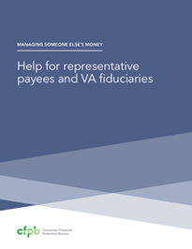
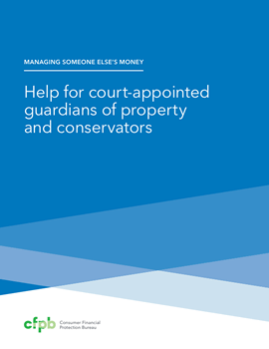
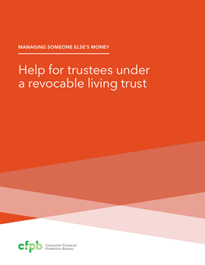

Managing Someone Else’s Money guides
Help for financial caregivers handling the finances for a family member or friend who is incapacitated
Guides for four common types of financial caregivers:
Agents under a Power of attorney
Guardians and conservators
Trustees
Social Security and Department of Veterans Affairs (VA) representatives
Includes tips on protecting assets from fraud and scams.
Available in English and Spanish
Notes:
Updated 11/29/2017

Slide 37
Resources
Consumer Financial Protection Bureau (CFPB):
Order publications including the Money Smart for Older Adults participant Resource Guide consumerfinance.gov/older-americans
ASK CFPB, consumerfinance.gov/askcfpb/
Submit complaints, consumerfinance.gov/complaint or by phone
1-855-411-CFPB (2372)
Notes:
Stock presentation copy - previously cleared for Tennessee presentation September 25, 2017
The Consumer Financial Protection Bureau (CFPB) offers several resources:
Print brochures on topics such as reverse mortgages, at http://promotions.usa.gov/cfpbpubs.html
An online resource called ASK CFPB, which contains authoritative, unbiased, understandable answers to commonly-asked consumer questions with a special section for older Americans, at http://www.consumerfinance.gov/askcfpb/
Consumers can submit complaints about credit cards, mortgages, car loans and other consumer loans, bank accounts and services, private student loans, credit reporting, money transfers, and debt collection. It is possible to submit a complaint on behalf of another (with third party authorization). Complaints can be submitted online at www.consumerfinance.gov/complaint/ or by calling
1-855-411-CFPB (2372)

Slide 38
Resources
www.fdic.gov/moneysmart
1-877-ASK-FDIC
www.mymoney.gov
1-888-MyMoney (Federal Website of Resources)
Notes:
Luke – FDIC cleared slide

Slide 39
Office for Older Americans
Email us:
Olderamericans@cfpb.gov
Find resources and mailing list:
consumerfinance.gov/practitioner-resources/resources-for-older-adults/

Slide 40
Group Exercise
Consider how Montana’s elder justice stakeholders can expand and enhance collaboration to prevent, address and resolve cases of elder financial exploitation.

