Slide 1
EVERFI
education for
the real world
Sean Thomas, Schools Manager
2017-2018

Slide 2

Agenda
About EVERFI
Instructional Resources
Getting Started

Slide 3
About EVERFI

Slide 4
EVERFI K-12
With a network of 20,000+ schools and hundreds of partners who share our mission, EVERFI delivers engaging digital resources, free of charge so teachers can equip students with critical skills for success beyond the classroom.

Slide 5
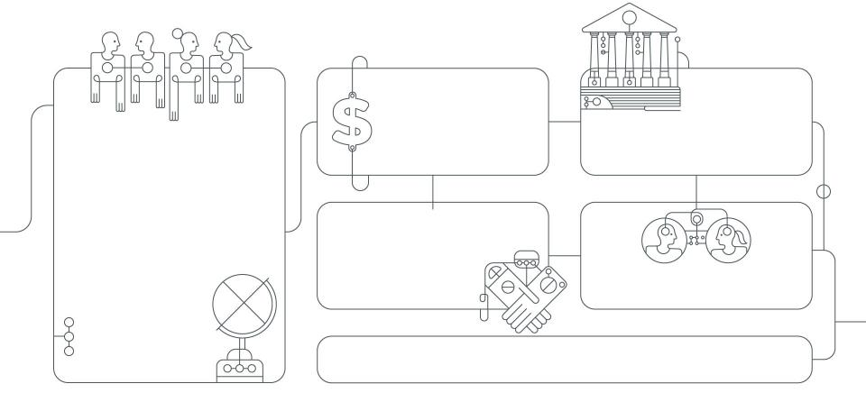
EVERFI
20,000
K-12
700+
Sponsor Partners
1,700
Higher Education
18 Million Learners
Across The United States and Canada
50,000+
Teachers
500 Employees
100+ Former Teachers/Administrators

Slide 6
Local Impact
146
7,000+
24,000+
SCHOOLS
PARTICIPATING
STUDENTS PARTICIPATING
CRITICAL SKILL HOURS
Sponsor Partners
NHL & NHLPA; Calgary Flames
MassMutual, Glacier Bancorp, First Community Bank
Standards
Common Core Math & ELA
Jump$tart National Standards
Next Generation Science Standards (NGSS)

Slide 7
What Sets Us Apart?
Sponsorship Model
Implementation Team

Slide 8
Instructional Resources

Slide 9




Educator Benefits
In addition to interactive digital resources aligned to your state standards, educators also receive:
Real time reporting to see your students’ baseline knowledge and growth
Lesson plans and discussion questions
Access to EVERFI’s ever-growing library of digital curriculum
Student scholarship opportunities

Slide 10
Financial Education | STEM Exploration | Citizenship & Diversity | Career Success | Health & Wellness | Summer Learning
Vault Understanding Money 4–6th Grade | Future Goals Hockey Scholar – Math 5–8th Grade | Commons Civic Engagement 8–10th Grade | Venture Entrepreneurial Expedition 7–10th Grade | Healthier Me Nutrition & Wellness 1st–4th Grade and 6–8th Grade | Summer Slugger Math & Literacy 4–5th Grade
FutureSmart 6–8th Grade | Future Goals Hockey Scholar – Science 5–8th Grade | 306 African–American History 9–12th Grade |  | Character Playbook Character Education 7–9th Grade
EVERFI Financial Literacy 9–12th Grade | Ignition Digital Citizenship 6–9th Grade |  |  | AlcoholEdu for High School 9–12th Grade
 | Endeavor STEM Literacy & Career Exploration 7–9th Grade |  |  | R_{x} Drug Abuse Prevention 9–12th Grade
e
e
m
m
h
m
h
e
m
e
m
e
m
h
m
h
h
m
h
h
m
h
h
e
Elementary School
m
Middle School
h
High School

Slide 11
Course Details
FutureSmart
Every Course:
Quick and Easy Setup
Resources
30 minute standalone modules
Standards Aligned

Slide 12
Feedback

Slide 13
Teachers Love EverFi!
Students Love EverFi!
“This is so much more than I thought we were getting!” - I.W., Bench Elementary School, Billings MT
“Sometimes something comes along, and you think ‘oh, yes, I am definitely going to use this!’ EverFi is one of those things!” - C.D., Bench Elementary School, Billings MT
“It is so easy to use, and the kids really enjoy it!” - M.T., Lakes Magnet Middle School, Coeur d’Alene ID
“It’s going good - [the students] told me today when they left ‘[K.C.], this is actually fun!’ ha!! I feel like it is age appropriate and making them think.” - K.C. Schroeder Middle School, Grand Forks ND
“It was exciting and the kids are thoroughly impressed (some times not easy to impress fifth graders)!” - L.F., Lewis and Clark Elementary, Missoula MT

Slide 14

Certified Teacher Program
"I use EVERFI resources because they put real life scenarios in an educational context. My students can learn at their own pace, and are fully engaged in the program. The units I teach are enhanced by the modules and I can monitor all their progress with a few mouse clicks."
Eileen Lennon
Technology Educator
New York City Public Schools
BloomBoard Micro-Credentials available in Financial Education and STEM

Slide 15
Checking In
After utilizing an EVERFI resource:
65%
feel they can play a positive role in resolving conflict
28%
are more interested in pursuing a STEM career
of students
of students
73%
believe it is important to contribute to solving problems in their community
93%
would recommend the EVERFI course they used this year to a fellow teacher
of students
of teachers

Slide 16
Course Details

Slide 17


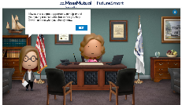

Grade level
6th – 8th
Structure
7 scenario-based modules
Learning time
3 – 3.5 hours
Standards
Jump$tart, NCSS
Course Highlights
Topics Areas
  7 modules, 30 minutes each
  Typically placed in Economics, Business or Social Studies classes
  Simulation-based learning embedded with real-world decisions
  Companion mobile app to reinforce positive financial behaviors
Financial Values & Goal-Setting
Budgeting and Opportunity Costs
Saving and Investing
Payment Types
Banking
Risk vs. Return
Planning for the Future

Slide 18

Venture
Entrepreneurial Expedition™
18
Highlights
Topics Areas
4 lessons, 20-45 minutes each
Typically placed in Business classes
Interactive Personal Diagnostic
Personalized Food Truck Business Simulation
Create an e-portfolio – a dynamic visual representation of their business pitch & career goals
  Budgeting and Building Startup Capital
  Generating Business Ideas
  Market Research
  Growing a Business
  Finances: The Cost of Doing Business
  Marketing: Promoting your Business
  Creating your Business Pitch
Grade Level: 7th-10th grade
Course Length: 2-2.5 hours
Aligns with Jump$tart, CEE, Common Core state standards

Slide 19

Character Playbook
Highlights
Topics Areas
  6 modules, 30 minutes each
  Typically placed in Health, Social Studies, or English class
  Covers key concepts around positive character development, social-emotional learning (SEL), and healthy relationships
  True-to-life scenarios including bystander intervention strategies and positive relationship examples
Analyzing Influences
Understanding and Managing Emotions
Communicating Effectively
Resolving Conflicts
Stepping In
Making Decisions
Grade Level: 7th - 9th
Course Length: 2 – 3 hours
Aligns with National Health Education Standards (NHES), CASEL Social and Emotional Learning Competencies, Common Core State Standards (CCSS)

Slide 20

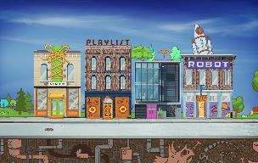
Endeavor
STEM Literacy & Career Exploration
20
At-a-Glance
Course Topics
Big Data and the Internet of Things
Future of Manufacturing and Design
The Algorithms behind Recommendations
STEM is everywhere, and we want students to see that. Through interactive problem-based scenarios, this course takes students into the science, technology, engineering, and math behind their world, and introduces them to inspiring careers they never knew existed.
Course Highlights
Interactive problem solving-based activities
Field guide with career profiles and personalized action plan
Diagnostic profile with recommended career paths
Pre and Post Assessments
Grade Level: 6th - 9th
Course Length: 1.5-2 hours
Aligns with Common Career Technical Core, Next Generation Science Standards, Common Core Math

Slide 21


Hockey Scholar™
Highlights
Topics Areas
6 modules, 20 minutes each (per version)
Math version and Science Version
Utilizes game of hockey to explore real-life STEM concepts
Each module structured to reinforce Scientific Method
Bonus STEM Career video content
  Experimental Variables
  Data & Graphical Analysis
  Calculating Area
  Kinetic & Potential Energy
  Phases of Matter
  Types of Forces
  Body Systems
  Distance vs. Time
  Geometric Constructions
  Coordinate Planes
Grade Level: 4th - 7th
Course Length: 3 - 5 hours
Aligns with State & Provincial Math/Science standards, NGSS, & CCSS Math

Slide 22


Prescription Drug Abuse Prevention
for High School
22
  At-a-Glance
  Prescription Drug Abuse Prevention is an innovative digital course that arms high school students with the knowledge and tools to make healthy, informed decisions when it comes to prescription medications. Through interactive scenarios and self-guided activities, students learn the facts about drugs, how to properly use and dispose of them, and how to step step in when faced with a situation involving misuse
  Course Highlights
  Evidence-based, public health approach to learning
  Interactive, true-to-life scenarios that reinforce key learning objectives
  Supplemental lesson plans
  Course Topics
  Opioids, stimulants, and depressants
  Proper prescription drug use, storage, and disposal
  Brain and body: the science of addiction
  Simulations: refusal and bystander skills
Grade Level: 9th - 12th
Course Length: 30-45 minutes
Aligns with National Health Education Standards (NHES)

Slide 23

Ignition
Digital Literacy & Responsibility™
Highlights
Topics Areas
7 modules, 30-45 minutes each
Typically placed in Computer/Technology classes
Nuts and bolts of how technology works
Virtual environments and simulations to tackle Digital Citizenship issues
Interactive My Digital Life capstone game
  Digital Footprint
  Internet Safety
  Cyberbullying
  Conducting Online Research
  Digital Time Management
  STEM Careers
Grade Level: 6th - 9th
Course Length: 3-4 hours
Aligns with State and ISTE Standards and fulfills CIPA objectives

Slide 24

Vault
Understanding Money™
for Grade School
Highlights
Topics Areas
6 modules, 30 minutes each
Typically placed in Math, Social Studies or Technology class
Embedded, performance-based games
Personalized offline goal-setting activities
Supplemental lesson plans for teachers
Savings Plans
Setting Financial Goals
Taxes
Income
Budgeting
Credit vs. Cash
Managing Risk
Investing
Borrowing
Needs & Wants
Grade Level: 4th - 6th
Course Length: 2.5 hours
Aligns with state and national Jump$tart standards

Slide 25

EverFi
Financial Literacy™
For High School
Highlights
Topics Areas
  9 modules, 45 minutes each
  Typically placed in Economics, Business or CTE classes
  Real-life guided practice simulations, like filling out the FAFSA or 1040-EZ forms
  Ability to share budgeting & higher education information with parents
Saving
Banking
Payment Types
Credit Score
Financing Higher Education
Renting vs. Owning
Taxes and Insurance
Consumer Protection
Investing
Grade Level: 9th - 12th
Course Length: 6 - 8 hours
Aligns with state and national Jump$tart and Common Core standards

Slide 26

AlcoholEdu™
for High School
Highlights
Topics Areas
5 modules, 20-30 minutes each
Typically placed in Health or Physical Education classes
Goal-setting tools & Adaptive Pathing
Pre- and post- behavioral survey data for your school
Companion parent course
  Peer Pressure
  Making Good Decisions
  Media Influence
  Underage Drinking Laws
  Bystander Behaviors
  Blood Alcohol Concentration
  Alcohol & the Brain
  Goal-Setting
  Addiction
  Tips for Talking to Parents
Grade Level: 9th - 12th
Length: 2 hours

Slide 27
Getting Started

Slide 28



Implementation Strategies
Introduction to New Material
Guided and Independent Practice
Flipped Classroom
Content Review
Capstone Project

Slide 29
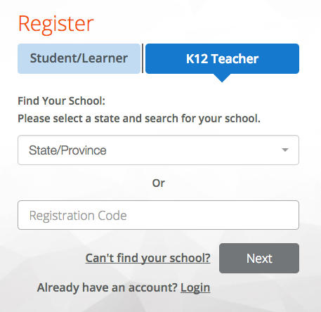

Registration
www.everfi.com/register
Select K-12 Teacher
Find Your State
Enter Your School

Slide 30
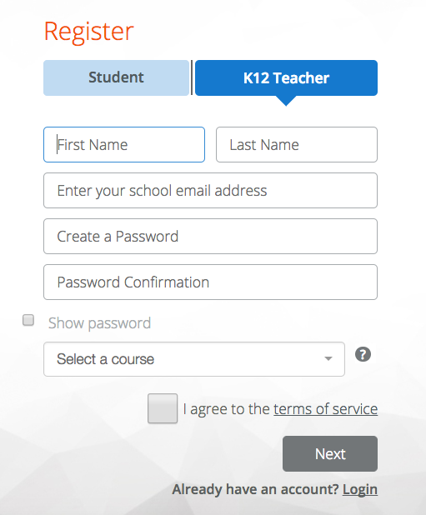
Your Profile
Complete Your Profile
Select a Course
Agree to Terms of Service

Slide 31
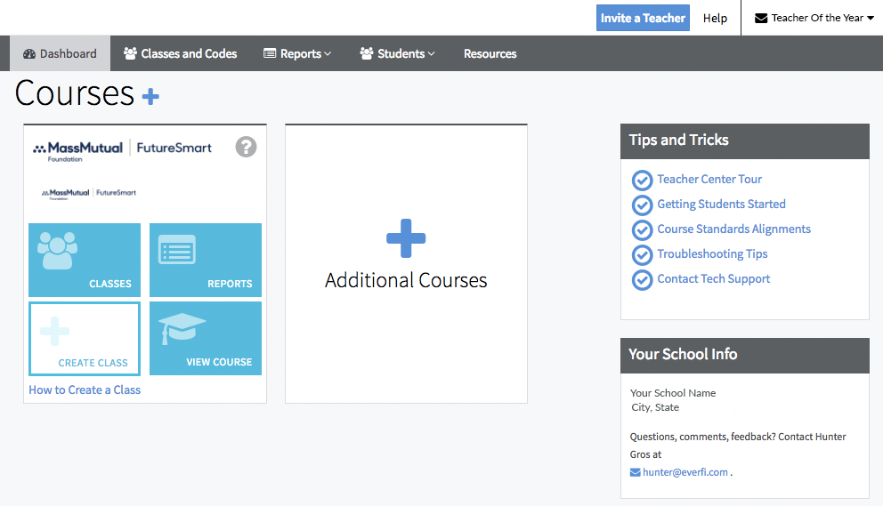

Slide 32
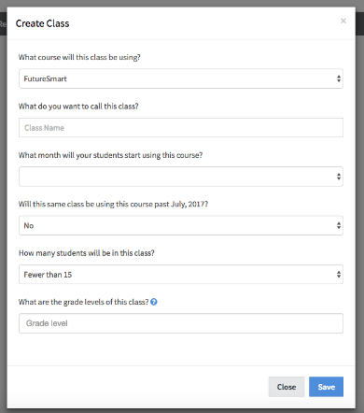

Slide 33
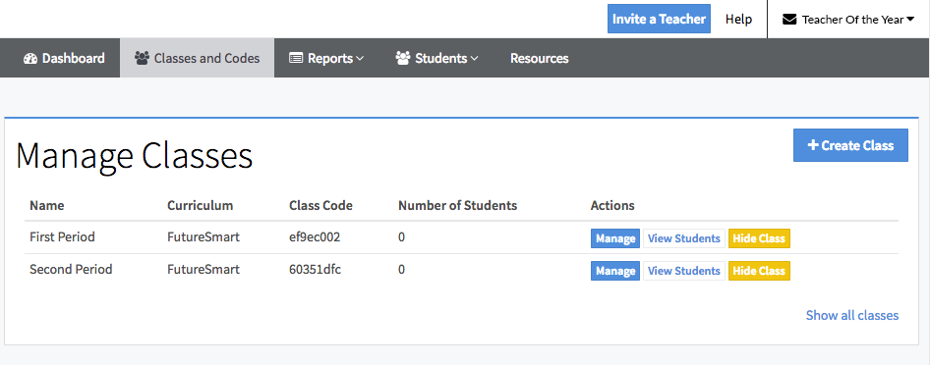

Slide 34
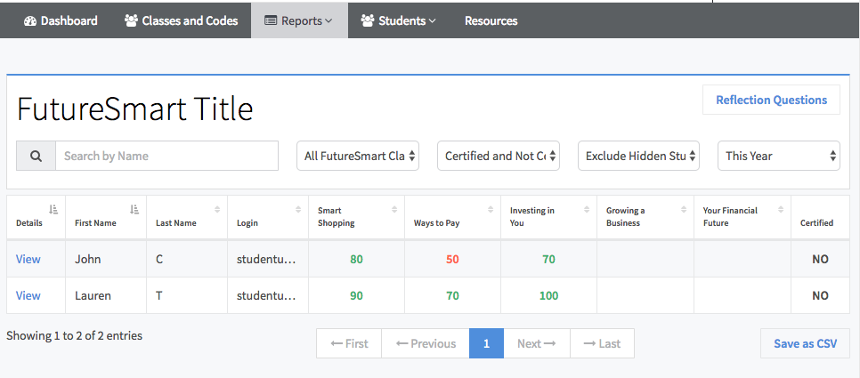

Slide 35
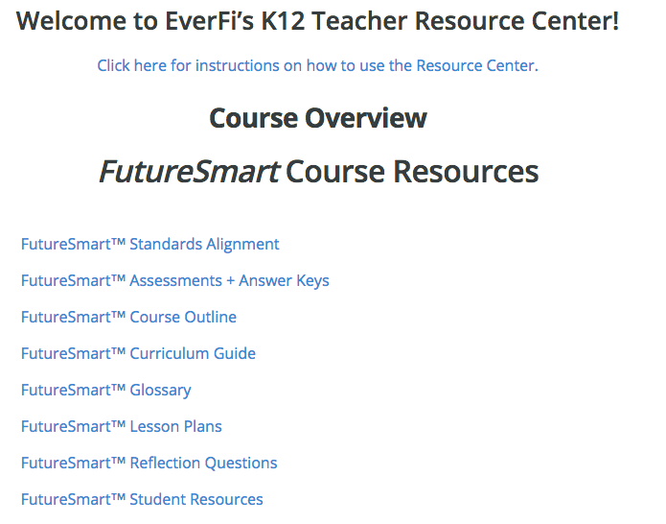

Slide 36
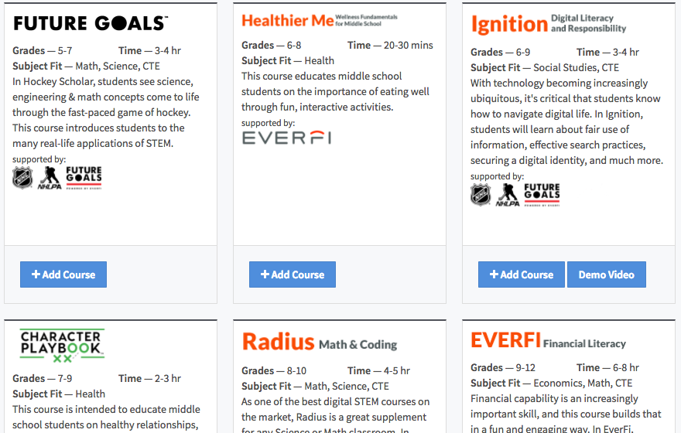

Slide 39
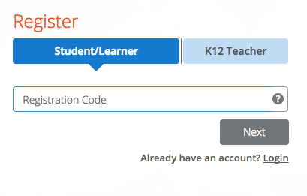
Student Registration
www.everfi.com/register
Enter Course Code

Slide 40
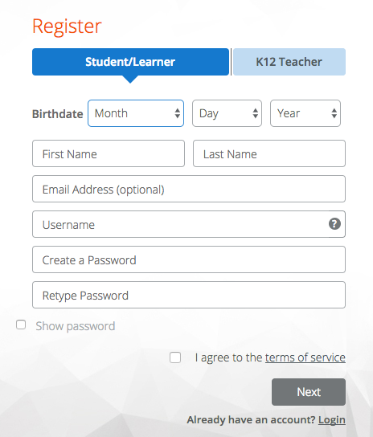
Student Profile
Enter Birthdate
Complete Profile
  Unique Username
  Password
    6 characters
    1 special character or number
Agree to Terms of Service

Slide 41



Best Practices
Determine how and when you plan to implement the modules
Review the lesson plans, discussion questions and vocabulary guides in the Resource Center
Reserve computers or devices as needed

Slide 42
Contact Me:
Sean Thomas
Schools Manager, Montana
Email: sthomas@everfi.com
Phone: 406.290.1136

Slide 44




Why We’re Here
Our Expertise
15+ Years in Online Education
Content Developed with Subject Matter Experts
Aligned to State and National Standards
Dedicated Implementation Team
76%
of millennials can’t answer basic financial wellness questions. ¹
of American high school seniors are proficient in math and interested in a STEM career.²
of middle schools report student bullying occurs at school daily or at least once a week.³
16%
22%
¹FINRA (2014) ²U.S. DOE ³NCES (2017)

Slide 45



Stay Connected
Like our K-12 Facebook Page for regular updates, articles and upcoming events
@EVERFI Twitter Account shares company-wide goings on
Quarterly INNOVATE Newsletter with best practices, Teacher Features, and K-12 company news

Slide 46

Commons
Digital Town Square™
46
Highlights
Topics Areas
  10 modules, 25 minutes each
  Typically placed in Government, Social Studies, or ELA classes
  Real-life guided practice simulations
  Embedded iCivics games to reinforce and extend course content
  Guided persuasive writing capstone activity
Rights of U.S. Citizens
Structure and Branches of U.S. Government
Elections and Voting
Juries and the Courts
Persuasive Writing and Debate
Taxes and Budgets
Duties of Elected Officials
Grade Level: 7th - 10th
Course Length: 5 hours
Standards: National Curriculum Standards for Social Studies, CCSS ELA

Slide 47

306
African-American History™
Highlights
Topics Areas
15 modules, 5-10 minutes each
Typically placed in Social Studies or ELA classes
Short vignettes focused on a specific person, event, or theme
Capstone project constructing an essay around a key theme from the course
  Trans-Atlantic Slave Trade
  Underground Railroad
  Phyllis Wheatley
  Frederick Douglass
  Hiram Revels
  Tuskegee Institute
  W.E.B. De Bois
  The Harlem Renaissance
  Brown vs. Board of Education
  Montgomery Bus Boycott
  The Freedom Rides
  March on Washington
Grade Level: 9th - 12th
Course Length: 2.5-3 hours
Aligns with state and national Jump$tart and Common Core standards

Slide 48

Healthier Me
Wellness Fundamentals for Elementary School
  At-a-Glance
  Healthy lifestyles start early, when our eating habits and fitness routines are just forming. This course turns familiar scenarios into teachable moments to build healthy behaviors students can use throughout their lives. From building a balanced plate to identifying the activities that will improve their endurance, students will learn to become a Healthier Me.
  Course Highlights
  Interactive scenarios to model and reinforce healthy behaviors
  Rich illustration and character animations to keep learners engaged
  Real-world food and fitness choices
Course Topics
Making healthy decisions
Eating well-balanced meals
Nutritional properties of foods
Benefits of physical activity
Grade Level: 1st - 4th
Course Length: 20 – 25 minutes
Aligns with National Health Education Standards (NHES),
USDA Dietary Guidelines

Slide 49
Healthier Me
Wellness Fundamentals for Middle School
  At-a-Glance
  Healthy lifestyles start early, when our eating habits and fitness routines are just forming. This course turns familiar scenarios into teachable moments to build healthy behaviors students can use throughout their lives. From building a balanced plate to making decisions at the grocery store, students will learn to become a Healthier Me.
  Course Highlights
  Interactive scenarios to model and reinforce healthy behaviors
  Rich illustration and character animations to keep learners engaged
  Real-world food and nutrition choices
Course Topics
Making healthy decisions
Eating well-balanced meals
Nutritional properties of foods
Setting Health-Related Goals
Grade Level: 6th - 8th
Course Length: 30 – 40 minutes (with surveys)
Aligns with National Health Education Standards (NHES),
USDA Dietary Guidelines

Slide 50



Summer Learning/
Summer Slugger
for High School
Summer Slugger™
Summer Slugger
Literacy and Math Reinforcement
Literacy and Math Reinforcement
Highlights
Topics Areas
36 individual games, each lasting around 10 minutes*
Interactive, gamified, mobile-friendly, baseball-themed activities
Motivation through points, levels, and progress-based rewards
Bonus challenges focusing on social-emotional, physical, and community-based tasks
  Units of Measure
  Place Value
  Arithmetic
  Geometry
  Spelling
  Phonemic Awareness
  Vocabulary
  Comprehension
Grade Level: 4th - 5th
Length: 6 hours
Aligns with Common Core State Standards (CCSS) and National Standards
* Games can be released at weekly intervals, or all at once

