Slide 1

Mini Grants

Slide 2
2018 Mini Grants
Montana Financial Education Coalition is proud to promote local efforts to expand financial education across our state
We hope that with the help of these mini-grants organizations will be able to implement activities in their communities with an emphasis on Financial Education and Consumer Protection
Mini grants can augment existing or new strategies/programs

Slide 3
2018 Mini Grants
Applications available today (will also be available via www.mtmfec.org) and must be returned by May 31, 2018
There will be a maximum of 10 grants awarded with the maximum of each grant being $750
Grant funds must be utilized by the end of December 31, 2018

Slide 4
2016 Mini Grant Recipients
Helena area Montana Youth Homes
Free Financial Education Classes for Women
Montana Association Business Professionals of America
MSU Extension
  Fort Peck Reservation
  Ravalli County
  Missoula County
  Custer County
  Stillwater County
  Teton County

Slide 5
Financial Literacy in Montana Youth Homes
Contact: Linda Leffler
Financial literacy sessions held for high school-aged residents of two different youth homes
Coordinated with Summer Red with Rural Dynamics who helped teach basic goal setting, budgeting and financial vision skills
Grant used for meal delivered to the residents at the completion of the exercises covered during the sessions

Slide 6
MSU Extension – Fort Peck Reservation
Contact: Wendy Becker
Financial literacy training about credit scores
Program focused on-what is credit, how do we obtain it, use it positively, and finally used two games to reinforce learning the objectives
  Credit Score Millionaire and Night of the Living Debt
Over 66 students participated in eight different classrooms, and 35 adults participated in the day long Tribal Financial Literacy workshop
Grant funds were used in combination with help from the Fort Peck Housing Authority and a ROSS Grant for the meeting room, meal and refreshments, booklets, and equipment

Slide 7
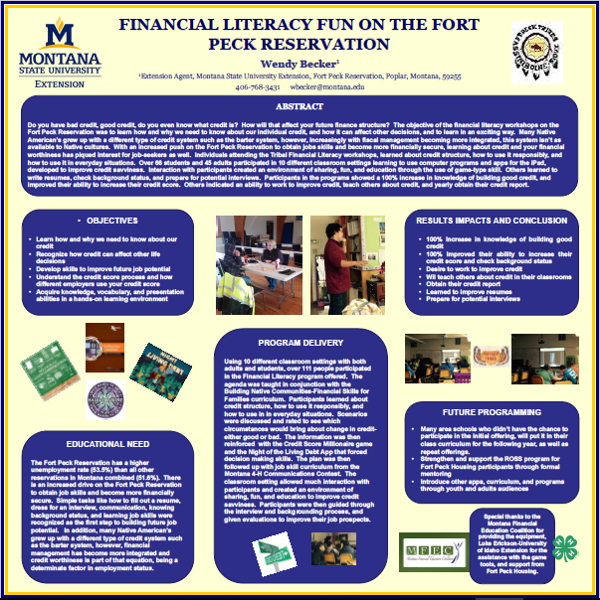

Slide 8
MSU Extension – Ravalli County
Contact: Katelyn Anderson
Grant funds were used to purchase an iPad Pro
iPad is used as part of the financial education classes taught by this extension office
  Hamilton High School
    Credit cards and credit scores
    Interactive…Night of the Living Debt
  Bitterroot Early Learning Center
    Saving and buying
    Interactive…Marlon Monkey Borrows Bananas

Slide 9
