Slide 1
The Case for Financial Education at All Ages: Recent Data
Billy J Hensley, Ph.D.
Senior Director of Education

Slide 2
What is NEFE?
National Endowment for Financial Education (NEFE)
Private Operating Foundation
National focus
Headquartered in Denver
How we fulfill our mission:
Education
Research
Awareness

Slide 3
NEFE Overview
NEFE Serves …
Youth up to retired adults
Those who have had limited access to financial education
People in difficult or unusual life circumstances
NEFE Partners with …
Financial educators and practitioners
Education institutions
Other nonprofits
NEFE Provides …
Grants for research about the field of financial literacy
Resources for consumers, educators, and facilitators

Slide 4
Why Research?
First, a little history. . .
Ongoing debate on the effectiveness of financial education
Number of participants
School focus
Research centers
Lack of quality and evaluation standards
Financial education vs. behavioral economics

Slide 5
Overconfident and Underprepared

Slide 6
Overconfident and Underprepared
The Disconnect Between Millennials and Their Money
Insights from the 2015 National Financial Capability Study: George Washington University

Slide 7
Overconfident and Underprepared
70 percent have at least one source of long-term debt (student loan, home mortgage, car loan) and
34 percent have more than one source of outstanding long-term debt.
23 percent of those with a self-directed retirement account either took a loan or made a hardship withdrawal in the prior 12 months.

Slide 8
Sample
25,000 respondents
23- to 35-year-old individuals for a total of 5,525 observations

Slide 9
Who are Millennials?
Approximately 80 million individuals
Larger in number, more ethnically diverse, and more educated than previous generations
By 2025, three out of every four workers globally will be Millennials
Poised to play pivotal role in the country’s social and economic development
Known for confidence and optimism

Slide 10
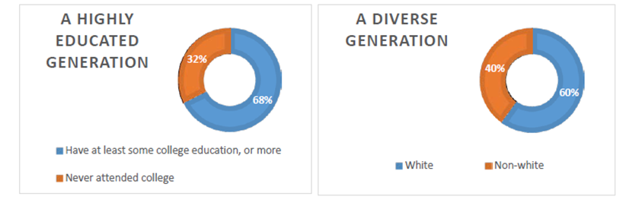
Who are Millennials?

Slide 11
Overconfident and Underprepared
A quarter of those with checking accounts had overdrawn their account in the prior 12 months.
A college education is associated with higher levels of debt across all sources of long-term debt.

Slide 17
Financial Literacy Questions
Follow this link for the 5-question Financial Literacy Assessment:
http://www.usfinancialcapability.org/quiz.php

Slide 18
Determinants of financial capability
Determinants of financial capability include financial literacy, education (some college or a degree) and the ability to deal with income shocks
Only 22 percent of Millennials have received some form of financial education

Slide 19
Financial Fragility: Evidence and Implications

Slide 20
Introduction
Financial fragility is determined by the ability to cope with emergency expenses in a short timeframe

Slide 21
Research Team & National Data
George Washington University’s Global Financial Literacy Excellence Center
2015 National Financial Capability Study
2015 Survey of Household Economic Decision-making
Six Focus Groups
Austin
Baltimore
Cincinnati

Slide 22
NFCS
Online survey of more than 25,000 respondents, commissioned by FINRA Investor Education Foundation.
It started in 2009, 2nd wave in 2012, 3rd wave in 2015
It is nationally representative
It offers unique information on financial literacy and capability
Financial fragility question asked in 2012 and 2015 wave

Slide 23
Financial Fragility Measure
How confident are you that you could come up with $2,000 if an unexpected need arose within the next month?

Slide 24
Amount in measure
How confident are you that you could come up with $2,000 if an unexpected need arose within the next month?
$2,000 approximates the amount needed to cover a major expense, such as a car or home repair, a large medical payment, or a legal expense.

Slide 25
Possible responses
How confident are you that you could come up with $2,000 if an unexpected need arose within the next month?
I am certain I could come up with the full $2,000
I could probably come up with $2,000
I could probably not come up with $2,000
I am certain I could not come up with $2,000
Don’t know
Prefer not to say

Slide 26
Definition of financial fragility
How confident are you that you could come up with $2,000 if an unexpected need arose within the next month?
I am certain I could come up with the full $2,000
I could probably come up with $2,000
I could probably not come up with $2,000
I am certain I could not come up with $2,000
Don’t know
Prefer not to say
Financially fragile

Slide 27
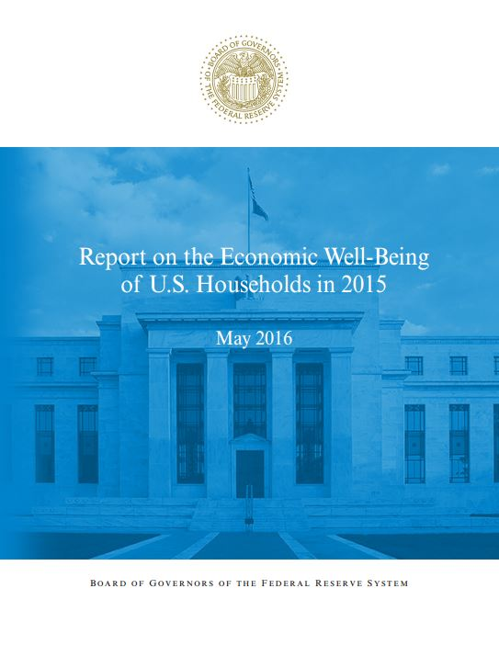
SHED
Online survey of more than 5,000 respondents, designed by the Federal Reserve Board.
It has been conducted annually since 2013
The data provide a snapshot of financial situations and expectations of households
Financial fragility question asked in all three waves
The SHED data substantiate the results obtained with the NFCS, and provide more insight into the debt and asset composition, and credit and financial behavior of individuals.

Slide 28
Alternate measure of financial fragility
Suppose that you have an emergency expense that costs $400. Based on your current financial situation how would you pay for this expense?

Slide 29
Amount measured
Suppose that you have an emergency expense that costs $400. Based on your current financial situation how would you pay for this expense?
$400 represents a smaller financial disruption that can occur in daily lives

Slide 30
Coping method measured
Suppose that you have an emergency expense that costs $400. Based on your current financial situation how would you pay for this expense?
Put it on my credit card and pay it off in full at the next statement
With the money currently in my checking/savings account or with cash
Put it on my credit card and pay it off over time
Using money from a bank loan or line of credit
By borrowing from a friend or family member
Using a payday loan, deposit advance, or overdraft
By selling something
I wouldn’t be able to pay for the expense right now
Other

Slide 31
Classification of financial fragility
Suppose that you have an emergency expense that costs $400. Based on your current financial situation how would you pay for this expense?
Put it on my credit card and pay it off in full at the next statement
With the money currently in my checking/savings account or with cash
Put it on my credit card and pay it off over time
Using money from a bank loan or line of credit
By borrowing from a friend or family member
Using a payday loan, deposit advance, or overdraft
By selling something
I wouldn’t be able to pay for the expense right now
Other
Financially fragile

Slide 32
Focus groups
When asked “How confident are you that you could come up with $2,000 if an unexpected need arose within the next month?” they answered, “I could probably not come up with $2,000” or “I am certain I could not come up with $2,000”
Have primary or shared responsibility for bill paying in their household
Represent a mix of races/ethnicities in each group
The demographic oversamples recruited for interviews were women, young people and blue-collar workers.
Notes:
Young: Men and women ages 18 to 34 who are not full-time students, not living with a parent/guardian, and not financially dependent on a parent/guardian
Blue Collar Workers: Men and women ages 25 to 60 who do not have a college degree, work part-time or full-time for an employer, and self-identify their job as “blue collar,” rather than “white collar or professional”
Women: A mix of married, single, and formerly married women ages 25 to 60, including women with college degrees and women who are not low-income

Slide 33
Financial fragility in the U.S.
35.7% are financially fragile
Source: NFCS 2015
43% are financially fragile
Source: SHED 2015

Slide 34
Financial fragility across age
Equal distribution across age
Fragility is slightly higher in the middle age group of 40- to 49-year-olds
Source: NFCS 2015
Notes:
This is counter-intuitive when we expect people to accumulate knowledge and plan better with age; middle-age could be because of many loans such as homes, cars while still paying off student debt; children too possibly

Slide 35
Financial fragility across household income
Financial fragility falls with income but is still high for the middle-income households.
Source: NFCS 2015
Notes:
30% of middle-income and 20% of high-income

Slide 36
Financial fragility across education levels

Slide 37
Financial fragility across gender
Women are substantially more financially fragile than men.
Source: NFCS 2015

Slide 38
Coping mechanisms of the financially fragile
Source: SHED 2015

Slide 39
Coping capacity of the financially fragile
Q. Based on your current financial situation, what is the largest emergency expense that you could pay right now using cash or money in your checking/savings account?
The large proportion of people who cannot even come up with $100 immediately suggests a grave problem of illiquidity
Some report being able to come up with more than $400 despite earlier saying that they would not use cash or their savings accounts to cope with a $400 expense – suggests inefficiency in handling personal finance
Source: SHED 2015

Slide 40
Underlying factors
Overall, 36% of the working-age population is financially fragile according to the NFCS and 43% in the SHED. Non-demographic factors associated with fragility:
Too much debt
Lack of assets
Lack of financial literacy
Financial fragility

Slide 41
Financial literacy and financial fragility
People who are financially literate are less likely to be financially fragile.
This effect of financial literacy is independent of the effect that overall educational attainment has on fragility.
Financial literacy can help with better financial planning and budgeting, better decision-making, and improvement in financial behavior.

Slide 42
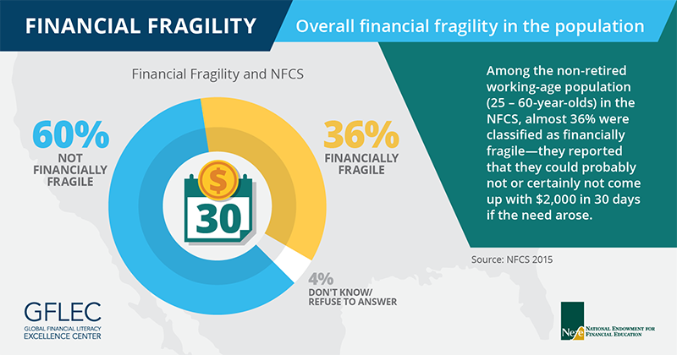

Slide 43
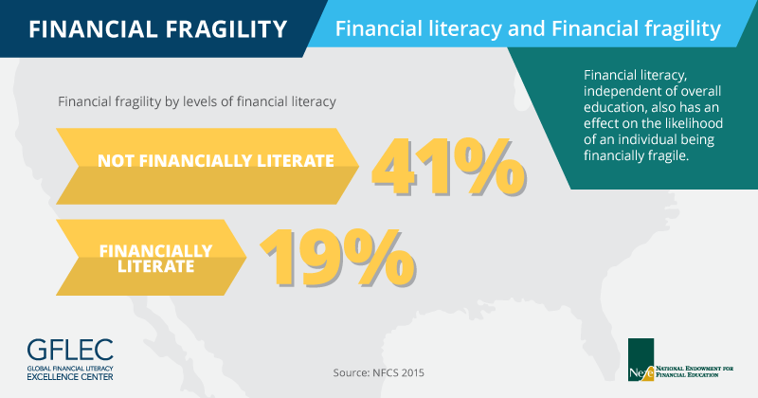

Slide 44
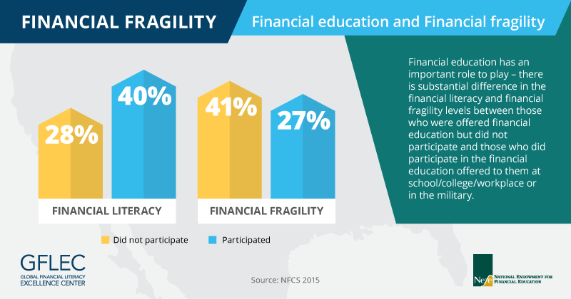
Effect of financial education

Slide 45
The Retirement Crisis

Slide 46
Retirement and Financial Education
George Washington University
Analyzes findings from the Organization for Economic Cooperation and Development (OECD)’s Program for International Student Assessment (PISA) financial literacy data and their implications for the development of sustainable retirement systems

Slide 53
Key Findings
Financial literacy depends heavily on socioeconomic status.
GDP per capita only explains 16 % of country-level variations in financial literacy, indicating that living in a developed country or being exposed to well-developed financial markets alone does not improve financial literacy.

Slide 54
What Type of Financial Education Works?

Slide 55
Not everything that calls itself financial education is effective…
Five Key Factors for Effective Financial Education
Well-trained Educator (tested e-learning protocol)
Vetted/Evaluated Program Materials
Timely Instruction
Relevant Subject Matter
Evidence of Impact (Evaluation)

Slide 56
Questions for Consideration
Why are the conversations dichotomous?
“Either/Or” should be replaced by “In addition to”
How do we build on what people already know?
How do we present entrepreneurship as an accessible and viable option for people of all ages, incomes, genders and races?

Slide 57
Questions for Consideration
How do we use entrepreneurial passion to build acumen?
How do we define “timely” and “relevant” in our work?
How do we integrate education best practices into the broader work of entrepreneurship education?

Slide 58
Concerns
Competing Ideas and Intent
Access to Quality Education
Competing Voices
Evaluation

Slide 59
Final Observation
When studying or considering future research and programming, think like a teacher…
Teachers work with various stakeholders to understand the factors that influence learning and behavior change and then work toward improvement.

Slide 60
NEFE Resources

Slide 61
CashCourse Overview
CashCourse is a free online resource, designed to provide students with financial education information for every stage of college life.
Unbiased, commercial-free content. No advertising!
Co-branded with your school
Relaunched in 2017 with new features

Slide 62
Resources for Financial Educators
11 Workshop kits: PowerPoint presentations & facilitators’ guides
Marketing templates: 8 flier designs
16 Worksheets
Assignments: Give your students assignments, track their scores
CashCourse Connection: Monthly e-newsletter
Webinars: Live how-to training presentations with Q&A
Reimbursement Program: Fall and Spring cycles

Slide 63

On Your Own is a trusted resource for young adults just starting out in the real world.
The blog provides young adults with an engaging educational experience.
On Your Own features entirely new branding, content and website design as of January 2018.
www.OnYourOwn.org

Slide 64


SmartAboutMoney.org
Consumer website
Six in depth e-learning courses
Five Money Basics courses
Self-paced
Access anytime

Slide 65
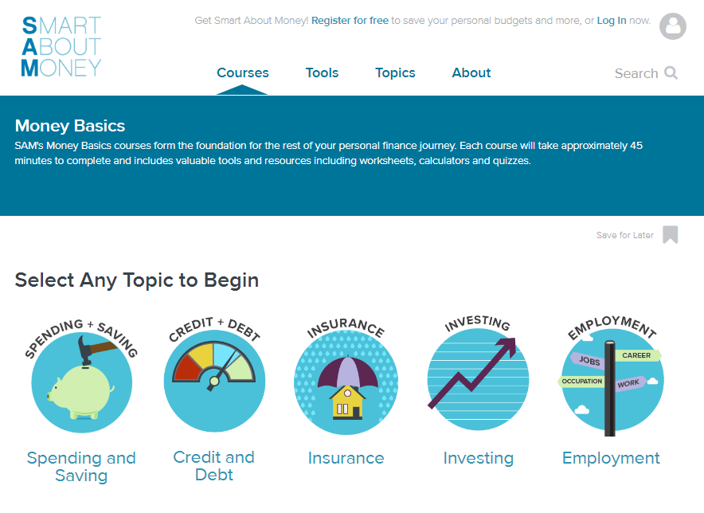
SmartAboutMoney.org

Slide 66

www.MyRetirementPaycheck.org

Slide 67
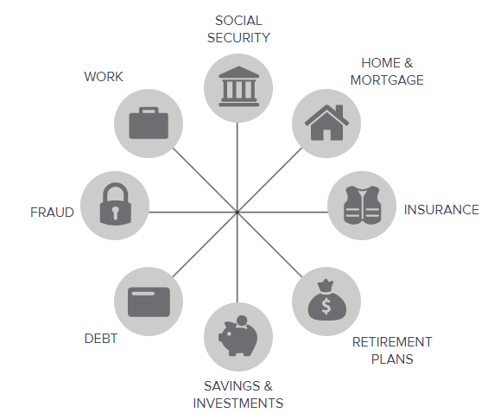

www.MyRetirementPaycheck.org
Notes:
67

Slide 68
Financial Workshop Kits
www.nefe.org

Slide 69
Financial Workshop Kits
www.nefe.org

Slide 70
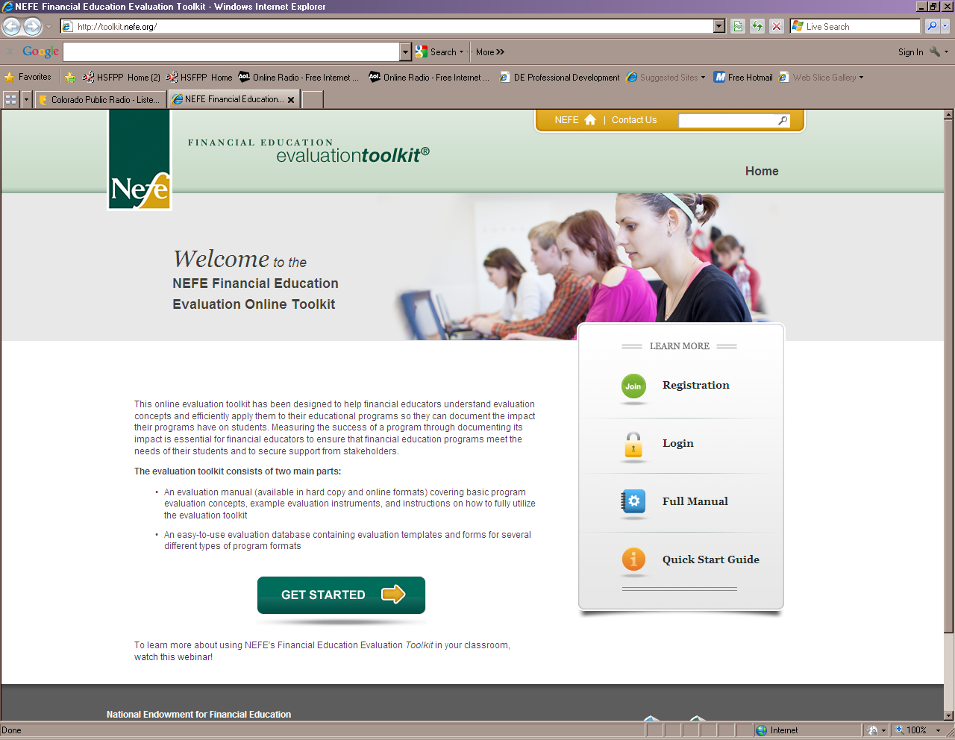
NEFE Evaluation Toolkit®
Track and evaluate program outcomes
Judge program effectiveness
Establish accountability

Slide 71

Standards-Based Curriculum
Comprehensive curriculum
Relevant to teens, grades 8 – 12
Instructor-led
Works in a classroom, workshop or one-on-one
Free printed student books
“This program equips you with everything that you need to teach.”
Allison, HSFP Instructor, Sparta, OH
HSFPP.org

Slide 72
Curriculum Components
6
Module Resources
Student guide books (print and online)
Letter home template
Modules
27
Lesson Resources
Teacher Lesson Plan
PowerPoint Show
Student Learning Plan
Activities and Handouts
Performance Assessment
Stand-Alone Lessons
(45-90 minutes each)

Slide 73
QUESTIONS?
www.nefe.org

